Slide 1
APEX:
APEX performance measurement and runtime auto tuning
Kevin A. Huck, Allen D. Malony, Sameer Shende, Wyatt Spear, Jordi Alcaraz , Luke Peyralans, Erik Keever
Oregon Advanced Computing Institute for Science and Society (OACISS)
For more information:
khuck@uoregon.edu
For more information:
khuck@uoregon.edu, tau-bugs@cs.uoregon.edu
https://github.com/UO-OACISS/apex

Slide 2

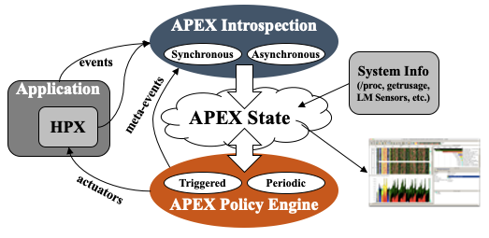
Autonomic Performance Environment for Exascale (APEX)
Autonomic Performance Environment for eXascale
Performance Measurement
Runtime Adaptation
Designed for AMT runtimes (originally HPX)
  but works with conventional parallel models
Focus on task dependency graph, not calling context graph
Supports HPX, C/C++ threads, OpenMP, OpenACC, OpenCL, Kokkos, Raja, Python, CUDA, HIP, SYCL, StarPU... Working on Iris, PaRSEC
https://github.com/UO-OACISS/apex and https://github.com/khuck/apex-tutorial
Active Harmony* (Nelder Mead), simulated annealing, genetic search, hill climbing, native Nelder-Mead for parametric search methods
https://doi.org/10.1109/ESPM256814.2022.00008 : “Broad Performance Measurement Support for Asynchronous Multi-Tasking with APEX”, Huck, ESPM, 2022

Slide 3
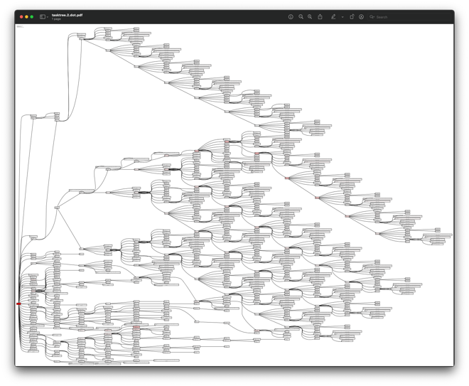
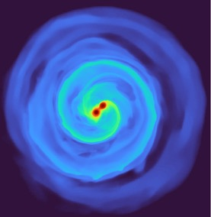
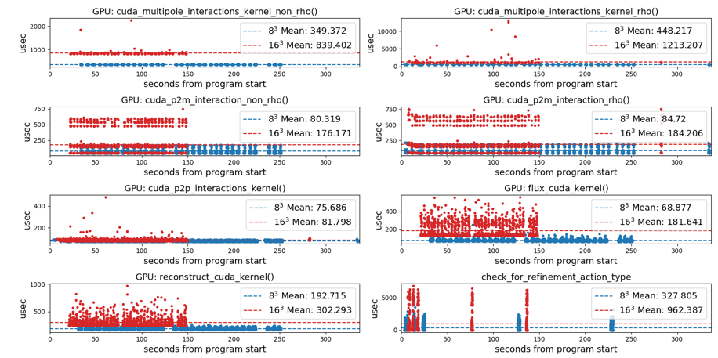
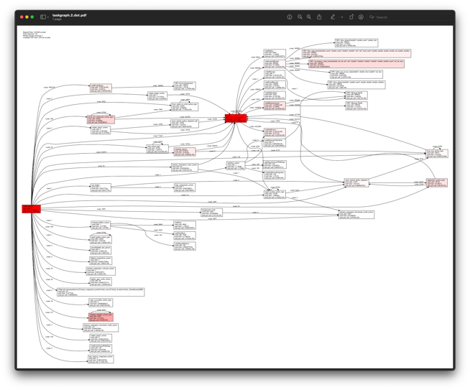
APEX example – Octo-Tiger (Octree astrophysics in HPX, Kokkos)
Tracking GPU memory usage with CUPTI
Monitoring GPU utilization with NVML library
Full task tree (above) and task graph (below) showing task dependencies
Comparing subgrid sizes and relative kernel performance with CUPTI device activity
https://github.com/STEllAR-GROUP/octotiger
https://github.com/STEllAR-GROUP/hpx

Slide 4
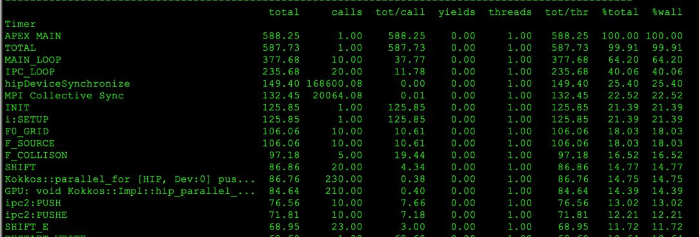
Example: XGC (tokamak plasma fusion PIC) on Frontier, 512 ranks
Uses support for MPI, OpenMP-Tools, PerfStubs, Kokkos, Hip
Post-processing view of MAIN_LOOP subtree, only with accumulated times > 5.0 seconds (only 72 nodes of 6298 of full task tree)
Red: MPI, blue: other, intensity = % of total subtree
OpenMP Kokkos Kernels
HIP Kokkos Kernels
Profiles collected with apex_exec, then post-processed with Python

Slide 5
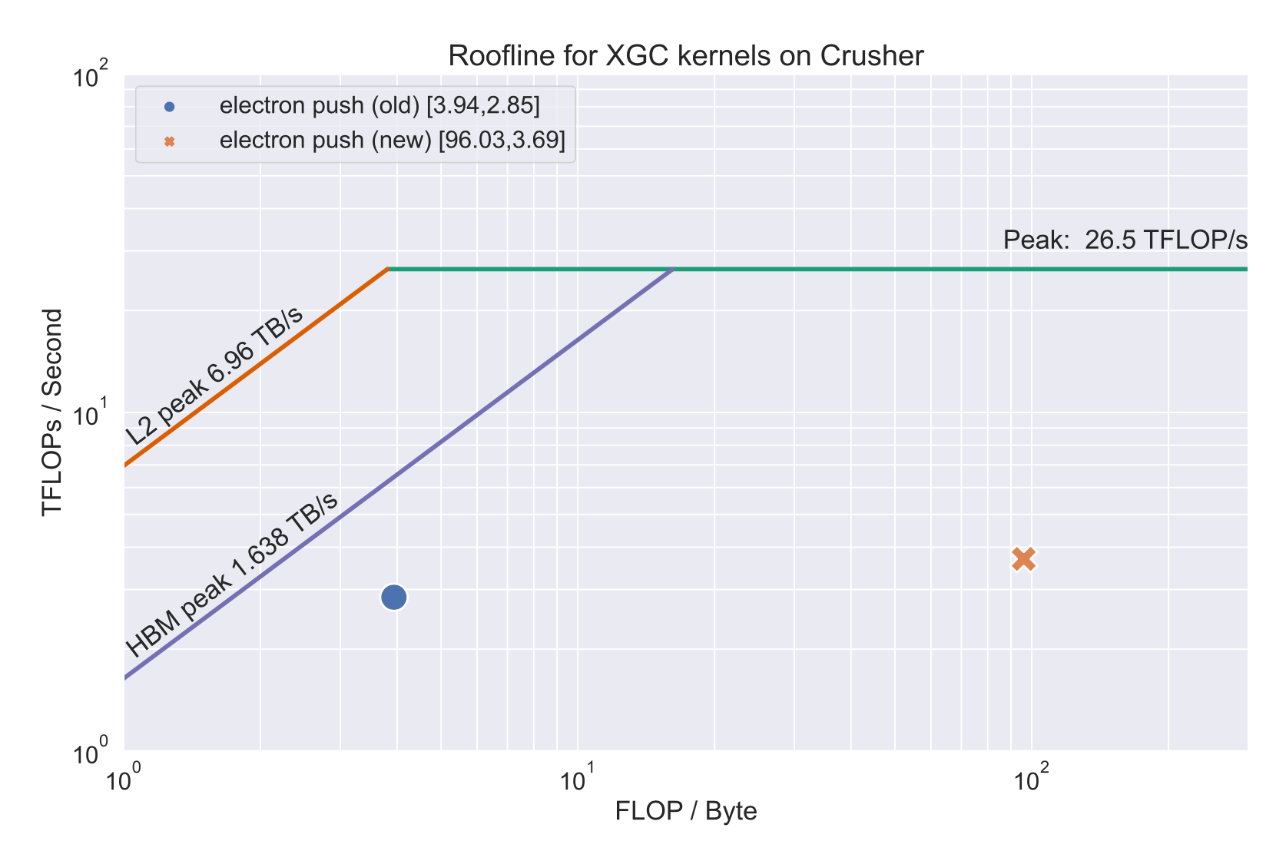
XGC: Push Kernel on Crusher/Frontier, Kokkos helped generate roofline
Cache | V100 | MI250X old | MI250X new
L1 | 99.8% | 87.6% | 98.7%
L2 | 95.4% | 58.8% | 94.1%
Increased computational intensity 25x, reduced time by 22% by using Kokkos launch bounds of <256,2>
Profiles collected with apex_exec, then post-processed with Python

Slide 6
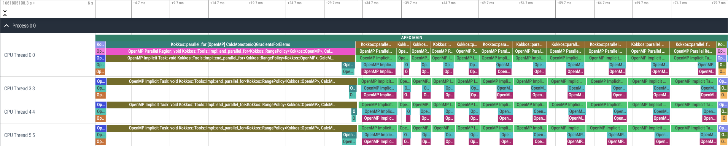
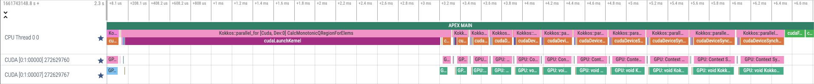
Kokkos Lulesh and APEX Tracing – OpenMP, CUDA, HIP back ends
OpenMP
CUDA
HIP
apex_exec --apex:gtrace --apex:[ompt,cuda,hip] …
Perfetto trace viewer: https://ui.perfetto.dev/

Slide 7
Kokkos Support in APEX
APEX implements the same profiling API that TAU does, and…
APEX provides runtime auto-tuning (parametric search) support
Kokkos provides the ability to autotune with:
-DKokkos_ENABLE_TUNING=ON
Automatically provides input and context variables for parallel_for, parallel_reduce, parallel_scan, parallel_copy.
  TeamPolicy: team size and vector length
  MDRangePolicy: tile sizes (block.x, block.y, block.z), 2 through 6 dimensions
  RangePolicy*: block size
  All policies: occupancy
  *(in a long-dormant development fork/branch…working on new integration because many kernels use RangePolicy)

Slide 8
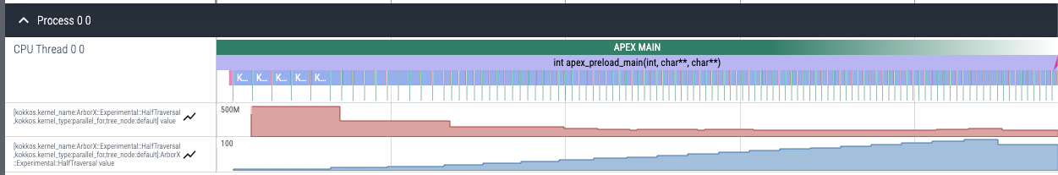
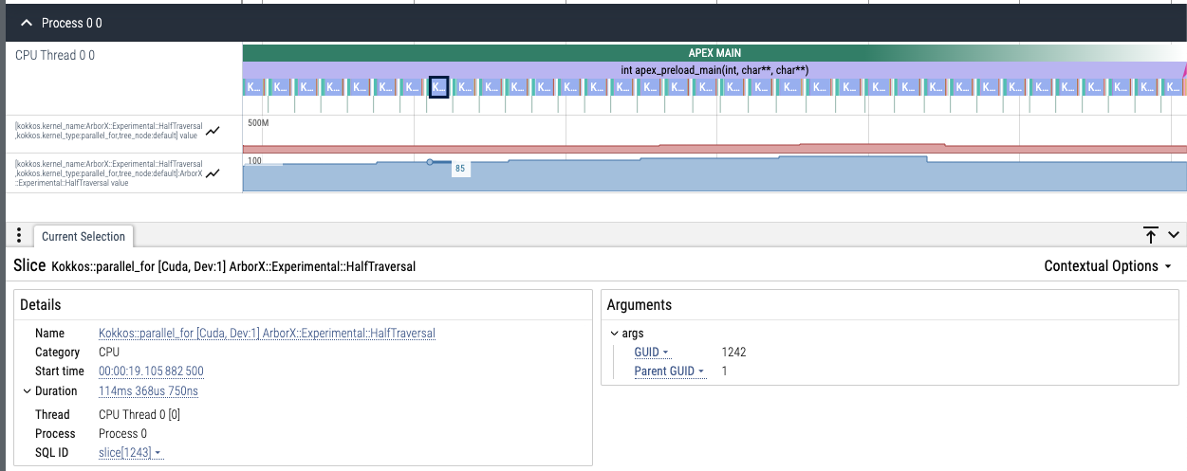
APEX Auto-tuning of ArborX DBScan with exhaustive search
Response (time)
Exploring occupancy %
Using window size of 5 (take at least 5 samples of each setting), occupancy converges on 85% (offline tuning showed convergence between ~45% and 90%), runtime reduced from 22 to 19.6 seconds (11% faster)
converges

Slide 9
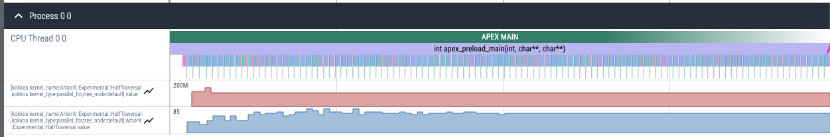
APEX Auto-tuning of ArborX DBScan with simulated annealing search
Response (time)
Exploring occupancy %
Using window size of 1, occupancy converges on 70% (offline tuning showed convergence between ~45% and 90%), runtime reduced from 22 to 19.6 seconds (11% faster)
converges

Slide 10
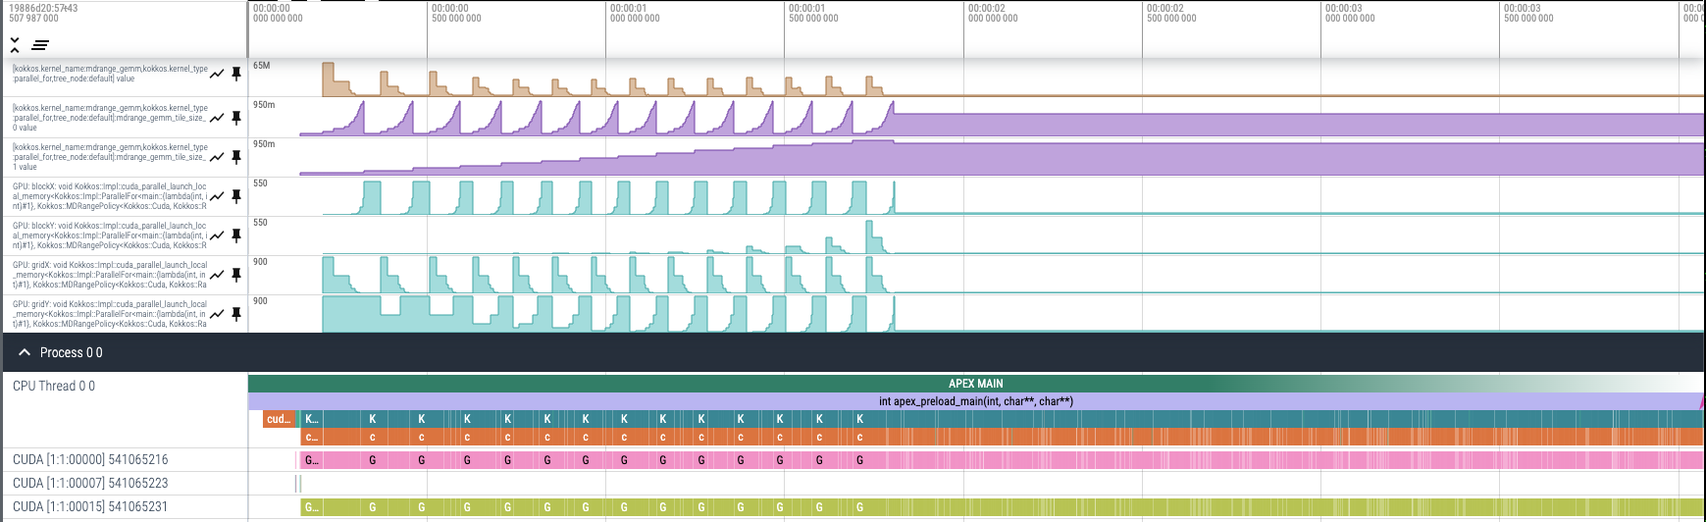
Example: testing mdrange_gemm 900x900 with exhaustive search
Response (time)
The tuning knobs (tiling factors)
32
Exploring block, grid sizes
16
29
57
Using window size of 2, tiling converges on block dimensions of (32,16,1) and grid dimensions (29,57,1), the defaults are (16,2,1) and (57,450,1) respectively. The runtime improved from a baseline of 3.95 seconds to 3.04 seconds using cached tuning results.
converges

Slide 11
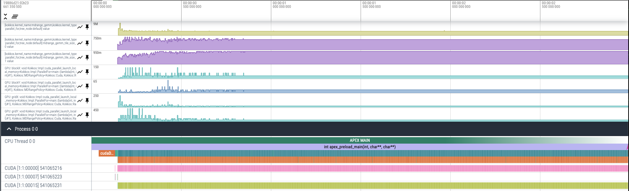
Example: testing mdrange_gemm 900x900 with simulated annealing
Response (time)
The tuning knobs (tiling factors)
32
Exploring block, grid sizes
16
29
57
Using window size of 2, tiling converges on block dimensions of (32,16,1) and grid dimensions (29,57,1), the defaults are (16,2,1) and (57,450,1) respectively. The runtime improved from a baseline of 3.95 seconds to 3.17 seconds using runtime simulated annealing.
Converges sooner

Slide 12



Acknowledgements
This work was supported by the Scientific Discovery through Advanced Computing (SciDAC) program funded by U.S. Department of Energy, Office of Science, Advanced Scientific Computing Research (ASCR) under contract DE-SC0021299.
Parts of this research was supported by the Exascale Computing Project (17-SC-20-SC), a joint project of the U.S. Department of Energy’s Office of Science and National Nuclear Security Administration, responsible for delivering a capable exascale ecosystem, including software, applications, and hardware technology, to support the nation’s exascale computing imperative.
This research used resources of the Oak Ridge Leadership Computing Facility at the Oak Ridge National Laboratory, which is supported by the Office of Science of the U.S. Department of Energy under Contract No. DE-AC05-00OR22725.
This material is based upon work supported by the U.S. Department of Energy, Office of Science, Office of Advanced Scientific Computing Research, Next-Generation Scientific Software Technologies program, under contract number DE-AC05-00OR22725.

