Slide 1

E4S:
Extreme Scale Scientific Software Stack
Allen D. Malony, Sameer Shende, Luke Peyralans, Wyatt Spear, Luke Peyralans, Erik Keever
Oregon Advanced Computing Institute for Science and Society (OACISS)
For more information:
sameer@uoregon.edu
https://e4s.io

Slide 2
What is E4S?
A community effort to simplify deployment of open source software for developing and running scientific applications on high-performance computing (HPC) and AI platforms
A Spack-based [https://spack.io] distribution of over 100 software packages including Trilinos, PETSc, MPICH, TAU, Kokkos, Raja and Python based AI/ML packages such as TensorFlow and PyTorch
Tested for interoperability and portability to multiple architectures with support for GPUs from NVIDIA, AMD, and Intel in each release
Available as source, containers, cloud and facility deployments, cached binaries
An open resource for all

Slide 3
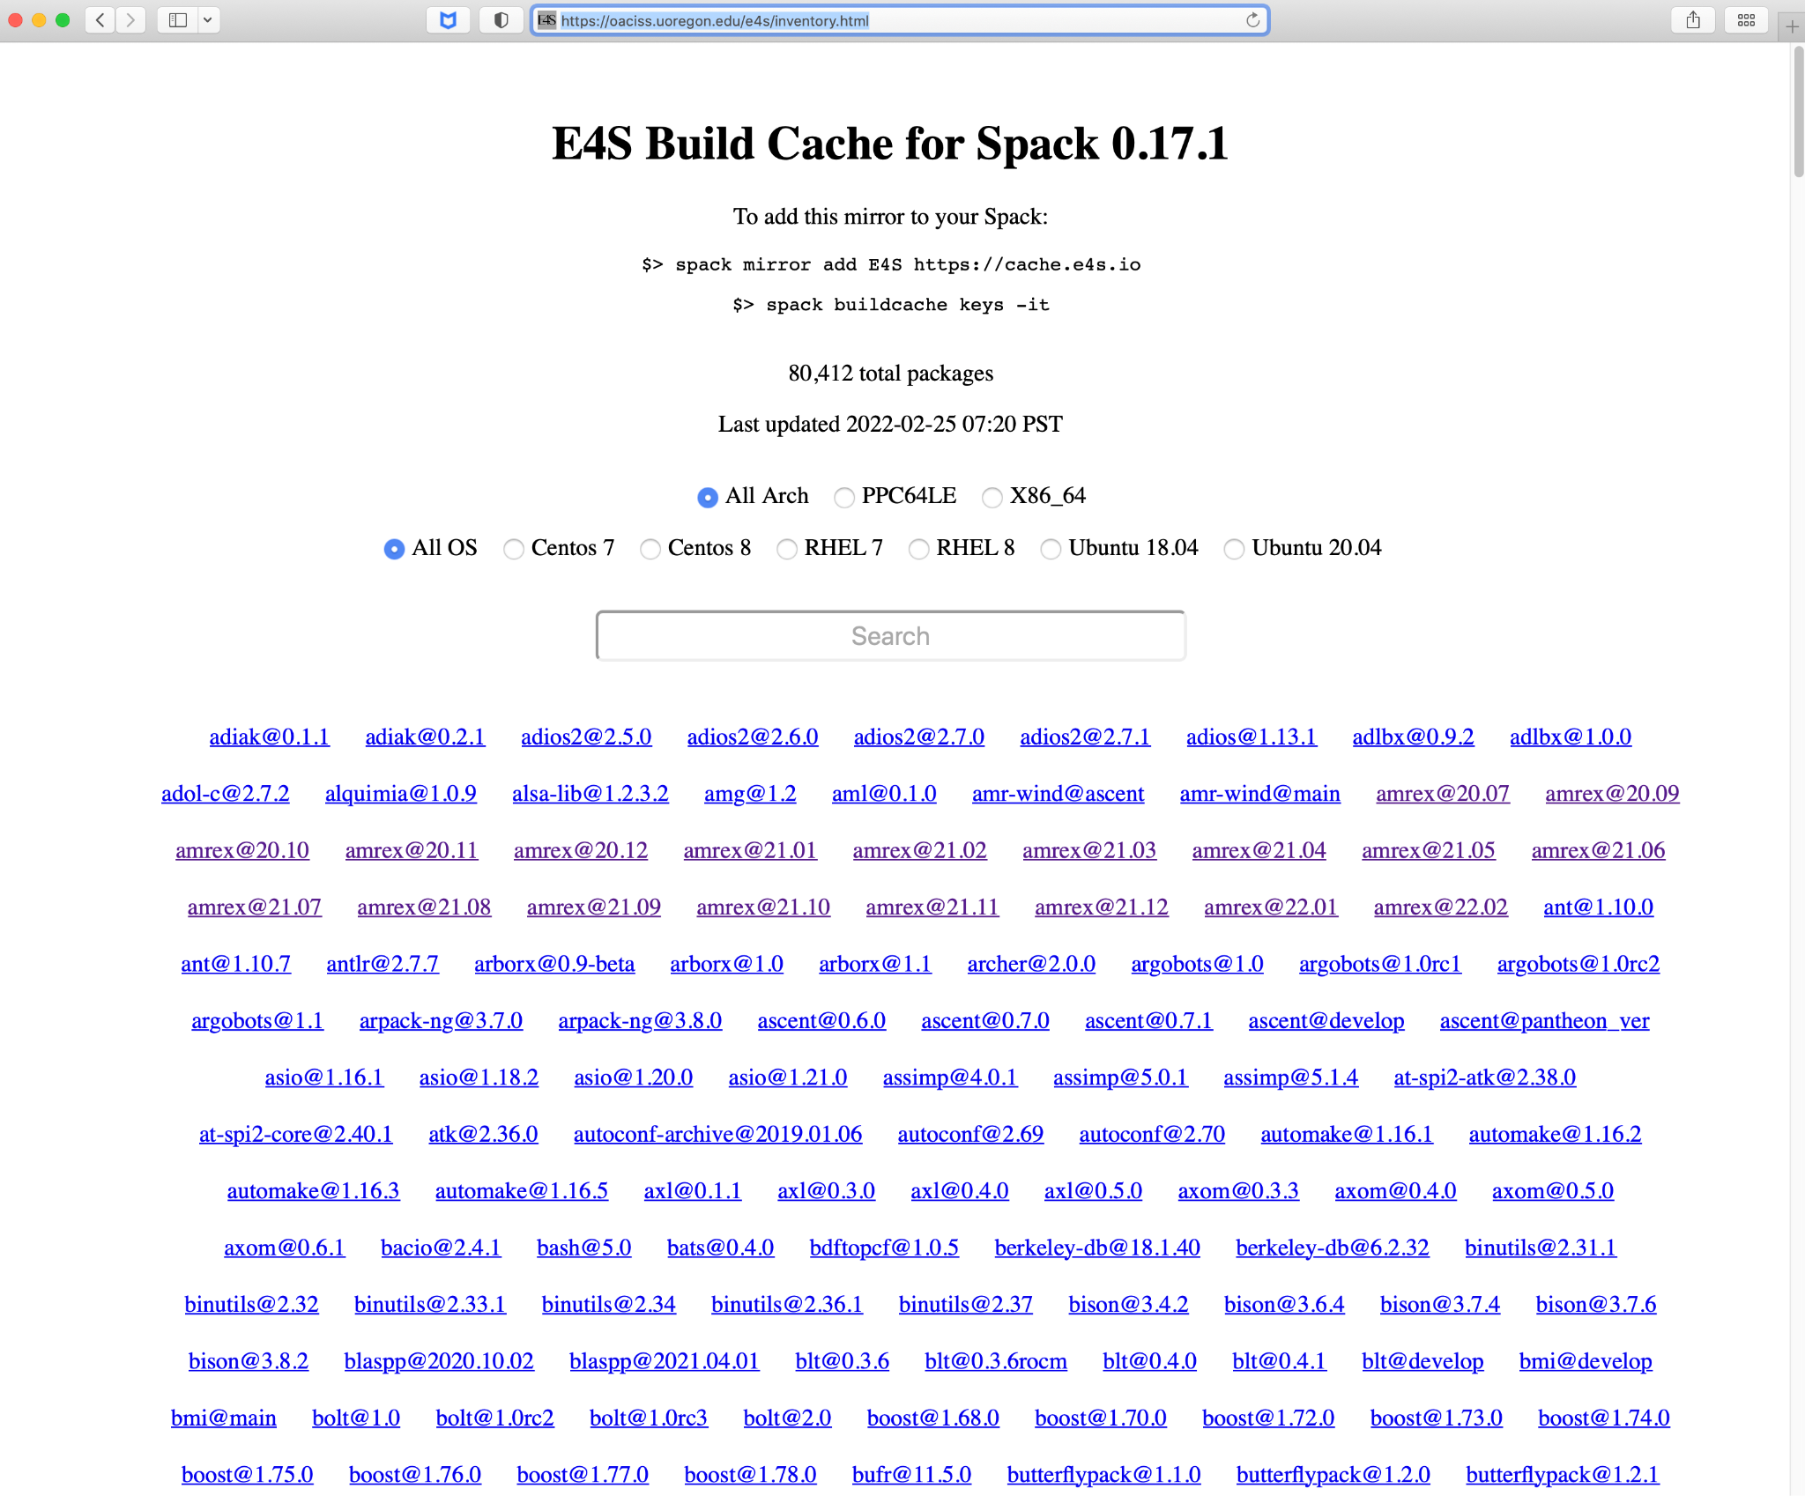
E4S Helps Software Developers and End Users
The E4S testing and CI infrastructure provides inter-product testing
E4S deployment makes products available to end users on important platforms
Spack recipes make it easier for developers and users to build on a variety of platforms
E4S build caches and containers lower the barrier to access product capabilities
Build caches massively reduce deployment times compared to source builds
E4S Spack Build Cache with 80,000+ binaries for installing packages.

Slide 4
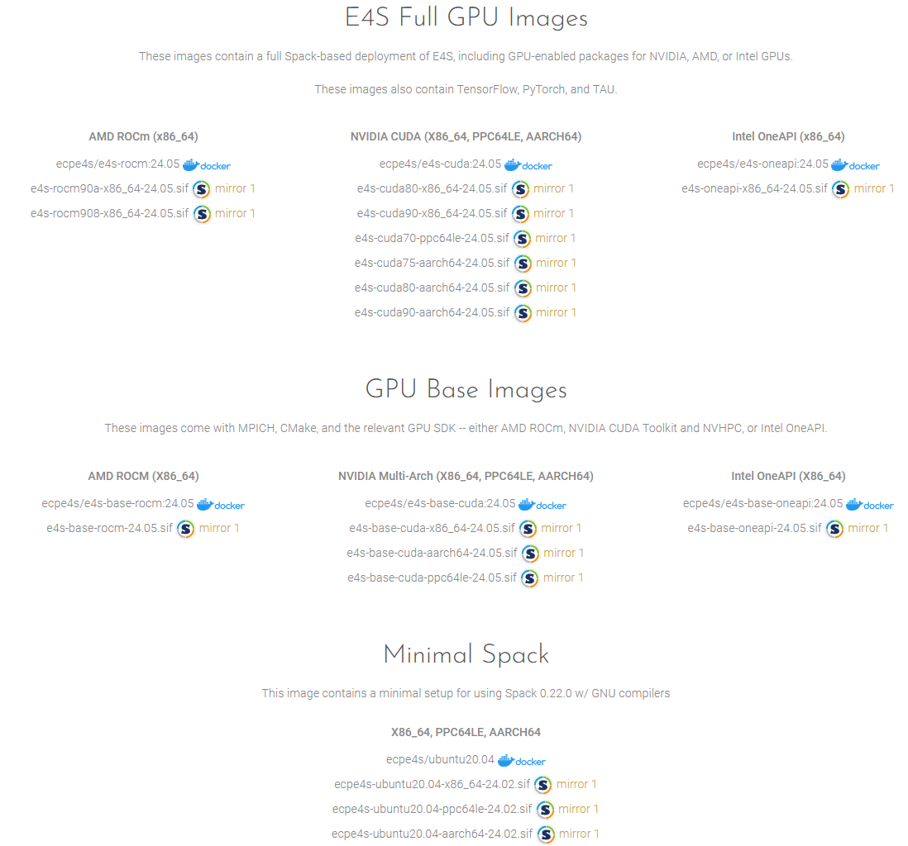
How E4S Works
A Spack package is created for the candidate product
The product is added to the E4S Spack environment
The E4S Spack environment is built with multiple combinations of compiler/hardware/accelerator
Sanity testing is conducted for the E4S products on each platform to ensure consistent functionality
The product is now available in E4S quarterly releases and can be installed via Spack from source or binary cache, or accessed at E4S-enabled facilities or in E4S containers
Container images generated for a quarterly E4S release

Slide 5
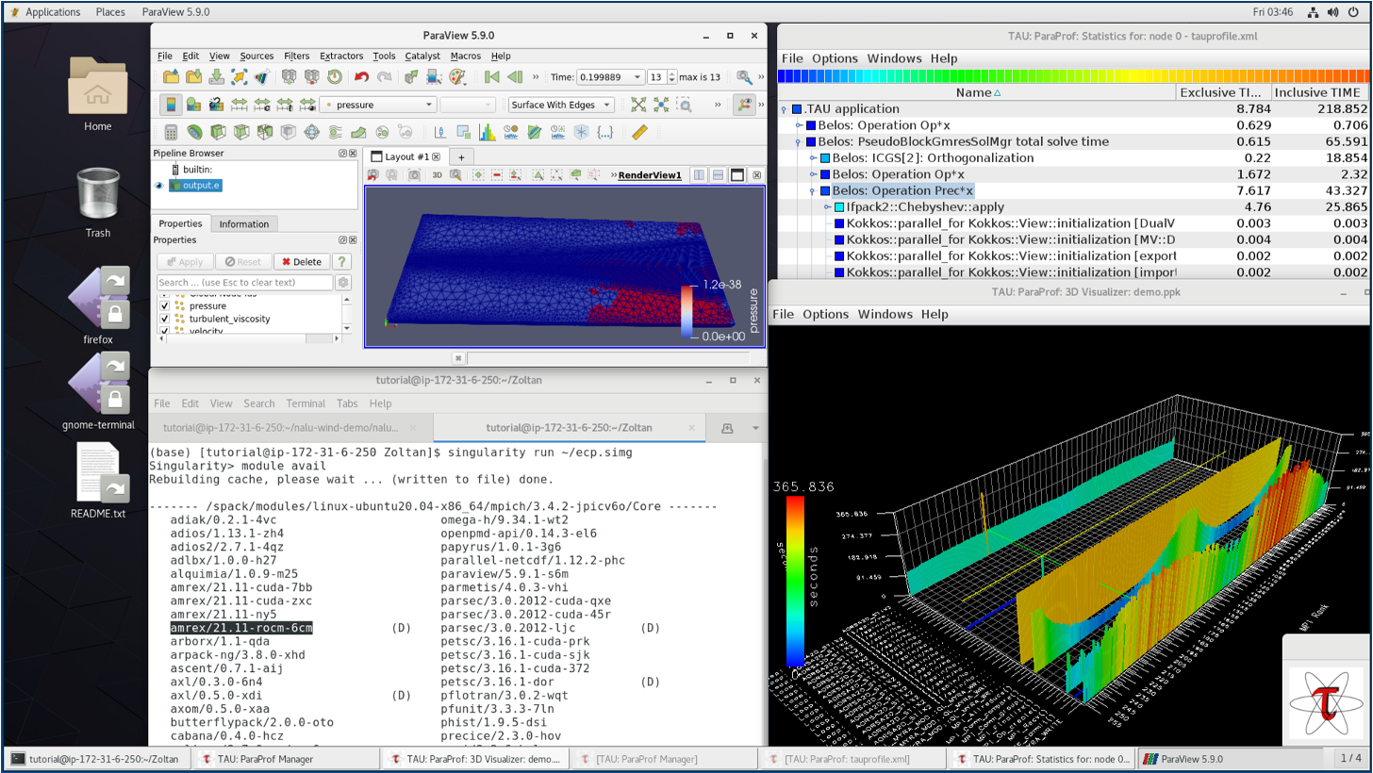
E4S Technology and Support
E4S-ALC: Allows selection of individual products to create custom E4S environments
E4S-CL: Enables execution of MPI applications inside containers using the host system’s MPI implementation
GitLab based CI
E4S Issue Tracker managed by ParaTools [https://www.paratools.com/] offers triage and troubleshooting for E4S deployment, Spack package and individual product related issues
Nalu-Wind Execution and Performance Analysis in E4S Container

Slide 6

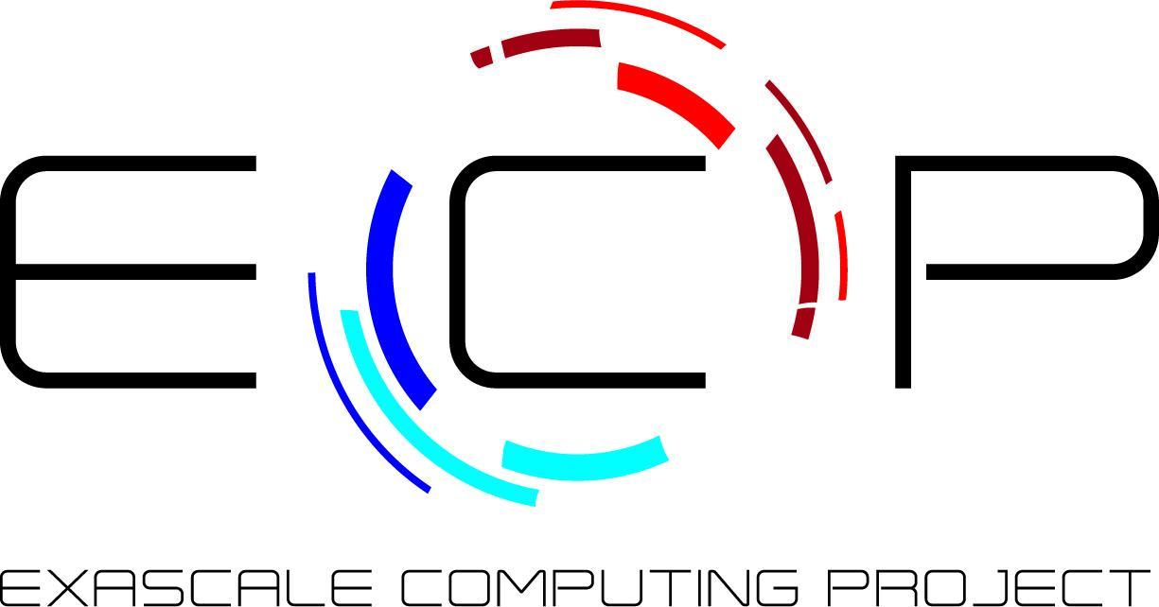

Acknowledgements
This research was supported by the Exascale Computing Project (17-SC-20-SC), a collaborative effort of two U.S. Department of Energy organizations (Office of Science and the National Nuclear Security Administration) responsible for the planning and preparation of a capable exascale ecosystem, including software, applications, hardware, advanced system engineering, and early testbed platforms, in support of the nation’s exascale computing imperative.
This material is based upon work supported by the U.S. Department of Energy, Office of Science, Office of Advanced Scientific Computing Research, Next-Generation Scientific Software Technologies program, under contract number DE-AC02-06CH11357.
Sandia National Laboratories is a multimission laboratory managed and operated by National Technology & Engineering Solutions of Sandia, LLC, a wholly owned subsidiary of Honeywell International Inc., for the U.S. Department of Energy’s National Nuclear Security Administration under contract DE-NA0003525.
SAND2021-4363 D

