Slide 1
OACISS:
Oregon Advanced Computing Institute for Science and Society
For more information:
https://blogs.uoregon.edu/oaciss/
https://github.com/UO-OACISS/

Slide 2
OACISS Mission
The mission of the Oregon Advanced Computing Institute for Science and Society (OACISS) is to be the intellectual leader and home for HPC-oriented research and HPC-enabled research at the University of Oregon
OACISS will promote computational and data science research excellence, engage with UO partners to create and grow HPC-driven research efforts, and pursue new research funding opportunities.
OACISS will also work to expand core competencies and expertise, support HPC education and training, encourage technology transfer in research domains successfully applying advanced computing methods, and represent UO’s image and visibility in this critical area.
We are investigating research ideas throughout UO where advanced computing can play an important role.

Slide 3


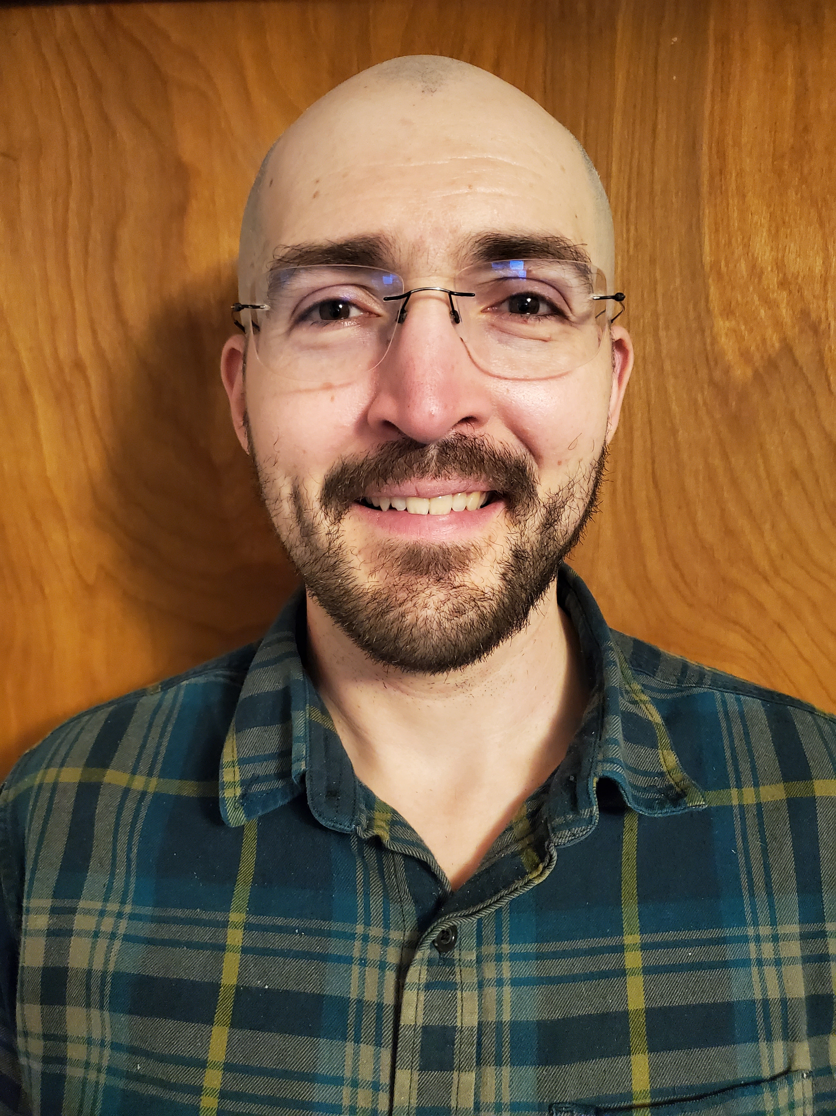
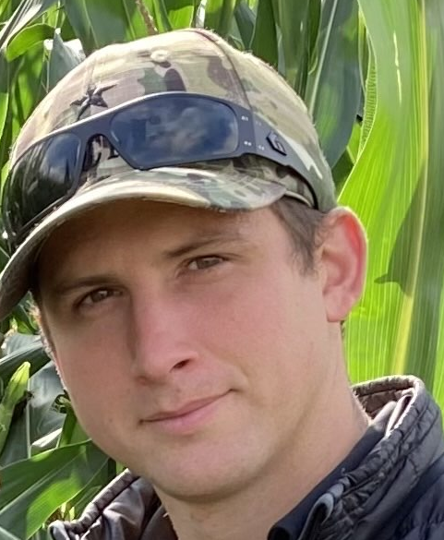
OACISSS Organization
Directors
  Allen D. Malony (OACISS Director)
  Sameer Shende (PRL Director)
Researchers
  Kevin Huck (Senior Research Associate)
  Jordi Alcaraz, Research Associate
  Erik Keever, Research Associate
  Wyatt Spear, Research Assistant
  Luke Peyralans, Research Assistant
OACISS
Performance Research Laboratory (PRL)
Neuro-
Informatics
Center (NIC)

Slide 4
OACISS Research
HPC performance analysis and tools
  TAU: Tuning and Analysis Utilities for HPC performance measurement
  APEX: Measurement and runtime auto-tuning for asynchronous tasking runtimes
  PerfStubs: Instrumentation stub library
  ZeroSum: Monitoring HPC process, thread, OS, and HW resources
  PDT / SALT: Instrumentation toolkit based on robust source parsers
Current Projects
  RAPIDS2: SciDAC Institute for Computer Science, Data, and Artificial Intelligence
  STEP: The Software Tools Ecosystem Project
  PESO: Toward a Post-ECP Software-Sustainability Organization
  S4PST: Sustainability for Node Level Programming Systems and Tools
  E4S: The Extreme-scale Scientific Software Stack

Slide 5
OACISS Funding
Department of Energy
  Office of Science
  Advanced Scientific Computing Research (ASCR)
  National Nuclear Security Administration
DOE National Laboratories: ORNL, LLNL, SNL, ANL
National Science Foundation
Industry partners: AMD, Intel, NVIDIA

Slide 6
For more information:
https://blogs.uoregon.edu/oaciss/research-groups
https://github.com/UO-OACISS
https://systems.nic.uoregon.edu/internal-wiki/index.php?title=Main_Page
https://systems.nic.uoregon.edu/internal-wiki/index.php?title=Category:Servers

