Slide 1
TAU:
Portable performance measurement toolkit for HPC
Allen Malony, Sameer Shende, Kevin A. Huck, Wyatt Spear, Jordi Alcaraz, Luke Peyralans, Erik Keever
Oregon Advanced Computing Institute for Science and Society (OACISS)
For more information:
tau-bugs@cs.uoregon.edu, https://tau.uoregon.edu,
https://github.com/UO-OACISS/tau2

Slide 2

TAU Performance System
Tuning and Analysis Utilities (29+ year project)
Integrated performance toolkit:
  Multi-level performance instrumentation
  Highly configurable
  Widely ported performance profiling / tracing system
  Portable (java, python) visualization / exploration / analysis tools
Supports all major HPC programming models
MPI/SHMEM, OpenMP, OpenACC, CUDA, HIP, SYCL/OneAPI, Kokkos...
Support for ML/AI frameworks: TensorFlow, pyTorch, Horovod, Python
Integrated with PAPI, LIKWID for hardware counter support
https://tau.uoregon.edu or https://github.com/UO-OACISS/tau2

Slide 3
Performance Measurement
Timers
  Requires instrumentation of some kind
    Manual, automated
    Source, compiler provided, binary
    Library callbacks, API wrappers, weak symbol replacement
  Simple to implement
Sampling
  Requires specialized system libraries / support (nearly universal)
    Periodic signals, signal handler
    Call stack unwinding
  No modification to executable/library needed
  Potential to interfere with system support (signal handlers)
  Can mix with timers to generate a hybrid profile

Slide 4
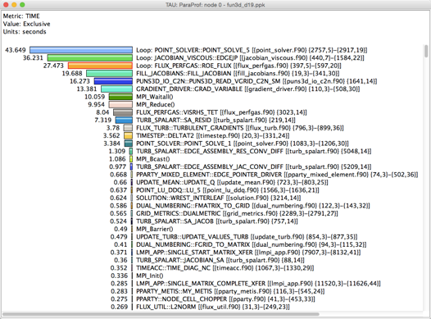
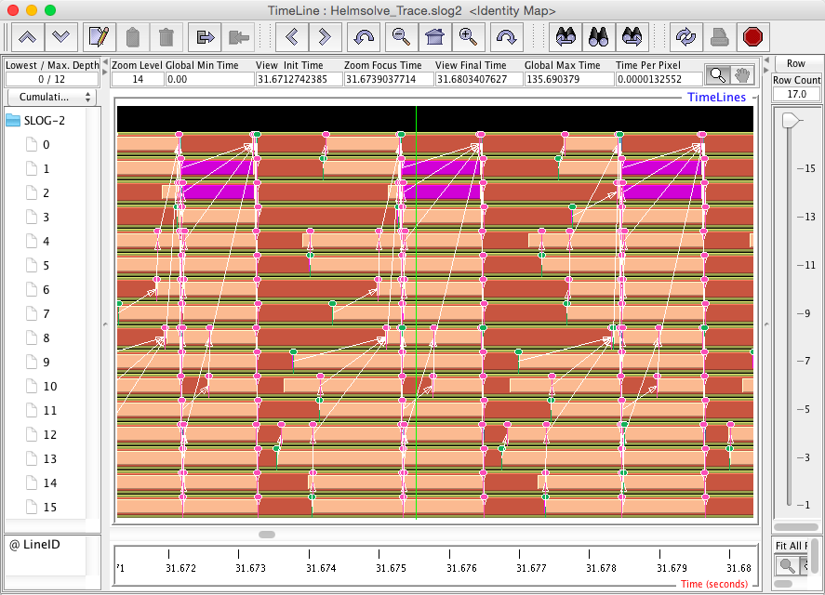
Profiling and Tracing
Profiling: how much time was spent in each measured function on each thread in each process?
  Collapses the time axis
  No ordering or causal event information
  Small summary per thread/process, regardless of execution time – only grows with number of timers & threads/processes
Tracing: record all function entry & exit events on a timeline
  Detailed view of what happened
  The longer the program runs, the bigger the trace
ParaProf profile viewer
JumpShot trace viewer

Slide 5
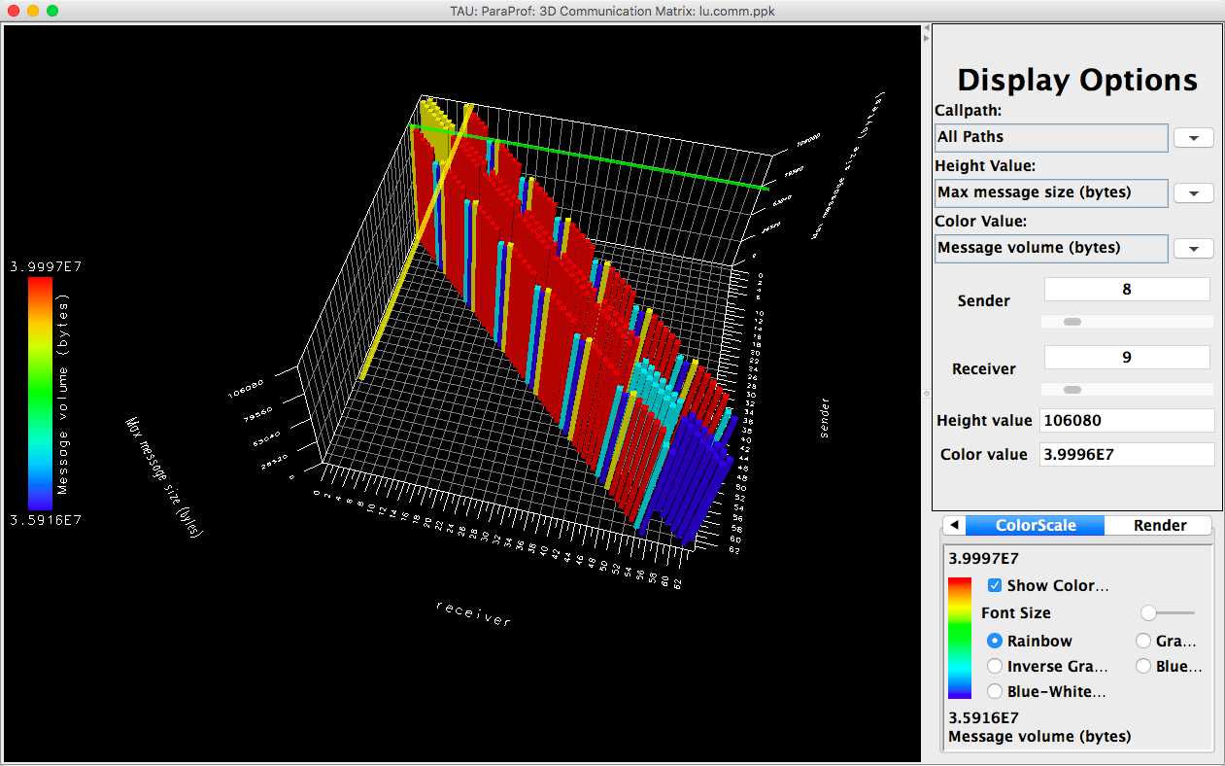
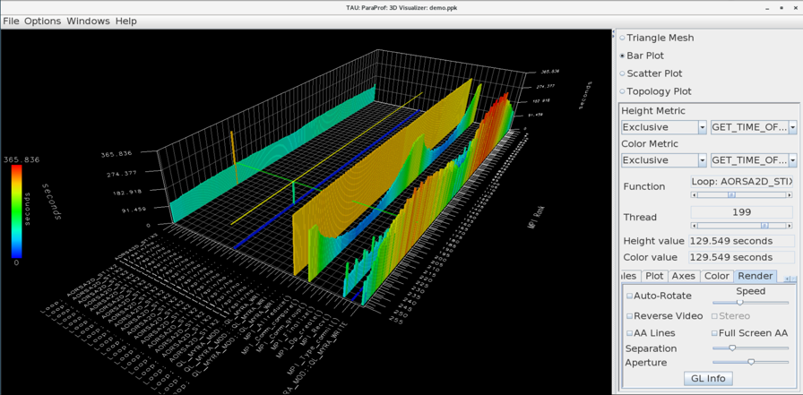
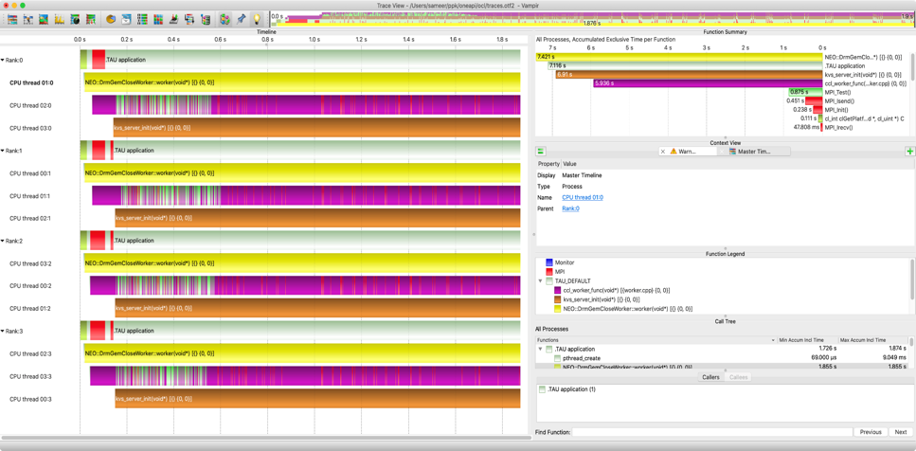
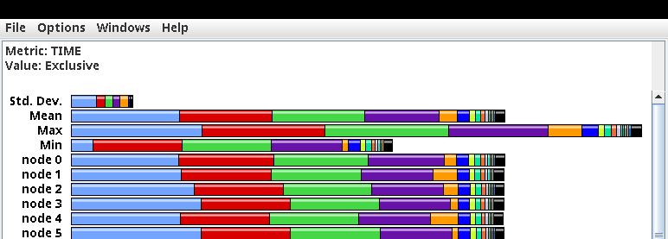
TAU Analysis Tools: ParaProf, Vampir
MPI Communication Matrix
3D Profile view
Vampir: https://vampir.eu
Profile view
Vampir trace viewer

Slide 6
Programming Model Support in TAU
MPI, SHMEM – interposition library to intercept all MPI calls
OpenMP – OMPT support (provided by all compilers except GCC), including target offload support
OpenACC – callback API similar to OpenMP
CUDA – measurement support through CUPTI, NVML libraries
HIP – measurement support through Rocprofiler, Roctracer, Rocm-SMI libraries
SYCL/Level0 – support provided through SYCL, Level0 APIs
Python – integration with cProfile, updated support in latest release for Python 3.12+ using low-overhead profiling API

Slide 7
Using TAU on Frontier
module load tau
srun <srun options> tau_exec -T <config> <options> your_executable
Useful options:
  -io : track I/O operations
  -rocm : enables HIP profiling support
  -cuda : enables CUDA profiling support
  -ompt : enables OpenMP Tools support (most compilers, not GCC)
  -ebs : enables sampling support
  -ebs_period=<count> : Sampling period in microseconds (default 10000)
  -ebs_resolution=<file|function|line> : choose sampling granularity
  -monitoring : enables periodic monitoring of system resources (a la ZeroSum)
tau-config --list-matching : shows installed TAU configurations

Slide 8
Kokkos support in TAU
TAU implements the Kokkos Profiling API (Kokkos_Profiling_C_Interface.h)
TAU sets an environment variable KOKKOS_TOOLS_LIBS to tell Kokkos that it should enable profiling and enable function callbacks to the TAU implementations
TAU implements
  kokkosp_[init|finalize]_library
  kokkosp_[begin|end]_parallel_[for|scan|reduce]
  kokkosp_[push|pop]_profile_region
Names for regions are passed to the tools to provide intelligent labels
In addition, TAU also implements support for native Pthreads, OpenMP, OpenACC, CUDA, HIP, SYCL back-end measurement – no code changes necessary
Raja support: if you have a Raja application, and Raja is configured with -DRAJA_ENABLE_RUNTIME_PLUGINS, Raja implements the same callback API

Slide 9
TAU Example – Kokkos Lulesh (from kokkos-miniapps)
Main thread launching kernels
Virtual thread with CUDA activity
Intel Xeon system with NVIDIA A100, size 256, 100 iterations, one rank

Slide 10



Acknowledgements
This work was supported by the Scientific Discovery through Advanced Computing (SciDAC) program funded by U.S. Department of Energy, Office of Science, Advanced Scientific Computing Research (ASCR) under contract DE-SC0021299.
Parts of this research was supported by the Exascale Computing Project (17-SC-20-SC), a joint project of the U.S. Department of Energy’s Office of Science and National Nuclear Security Administration, responsible for delivering a capable exascale ecosystem, including software, applications, and hardware technology, to support the nation’s exascale computing imperative.
This research used resources of the Oak Ridge Leadership Computing Facility at the Oak Ridge National Laboratory, which is supported by the Office of Science of the U.S. Department of Energy under Contract No. DE-AC05-00OR22725.
This material is based upon work supported by the U.S. Department of Energy, Office of Science, Office of Advanced Scientific Computing Research, Next-Generation Scientific Software Technologies program, under contract number DE-AC05-00OR22725.

