Slide 1
ZeroSum:
User Space Monitoring of Resource Utilization and Contention on Heterogeneous HPC Systems
Kevin A. Huck, Allen D. Malony, Sameer Shende, Wyatt Spear, Jordi Alcaraz, Luke Peyralans, Erik Keever
Oregon Advanced Computing Institute for Science and Society (OACISS)
For more information:
khuck@uoregon.edu, tau-bugs@cs.uoregon.edu
https://github.com/UO-OACISS/zerosum
Notes:
Good morning! Happy to be here again. This is an updated version of a talk that I have given at both a Dagstuhl seminar (23171, Driving HPC Operations With Holistic Monitoring and Operational Data Analytics) and the HUST workshop publication at SC23.

Slide 2
Performance Analysis Perspective on Monitoring
Three main classes of performance optimizations:
Algorithmic replacement (usually a high level of difficulty)
  E.g. replace O(n²) with O(nlogn)
  Can involve data structure changes, new dependencies, major rewrites
Code optimization (usually a medium difficulty)
  Improve cache reuse, reduce stalls (branching, instructions, I/O, etc)
Optimized launch configuration (low difficulty, high embarrassment potential)
  Misconfiguration
  Wrong assumptions from another system/application
  Changes to system policies/defaults (e.g. reserved cores)
Notes:
Skip the blah blah, jump right to the fact that many performance “bottlenecks” are misconfigurations – not research result worthy in most cases, just embarrassing

Slide 3
(Mis)Configuration – what could possibly go wrong?
Process placement:
  Logical/physical mappings, resources assigned/constrained to each process
  Are there reserved core(s) for system? GPU mapping?
Thread placement: Socket, NUMA domain, core, thread (HWT)
Undersubscribing: Wasted hardware, energy, time (under-utilization)
  Can provide better performance in some situations (memory-bound code)
Oversubscribing: Increased contention with no realized benefit
Imbalances
  What is the communication frequency/volume between pairwise MPI ranks?
Slurm/PBS/Alps/Torque/Flux are complicated to use
  …especially when combined with MPI, OpenMP, GPUs, or other model settings
Notes:
These are all things that experienced users know… but sometimes forget.

Slide 4
ZeroSum: User Space Monitoring of Resource Utilization and Contention
Inspired by the hello_jsub program from Tom Papatheodore: https://code.ornl.gov/t4p/Hello_jsrun
Why “ZeroSum”? – An advantage for one side results in an equivalent loss for the other
  the fixed number of resources available in an allocation – no elasticity
  the need to periodically use some resources to monitor
Available on GitHub: https://github.com/UO-OACISS/zerosum
Monitors application threads (LWP), CPU hardware (HWT), Memory, and GPU hardware for all processes, all nodes in the allocation
Notes:
Prototype solution to two problems:
Configuration optimization – help understand new system/software
Ongoing usage for monitoring

Slide 5
ZeroSum Functionality
Detect the initial/changing configuration of the application
Evaluate the configuration to automatically detect misconfigurations
Provide runtime feedback to the user that the program is progressing
Provide a report of how effectively the hardware was utilized
Provide a report of how much contention was identified in the execution
Provide a way to expose the observed data to other tools that can perform computational steering / runtime optimization / reconfiguration
Implemented
Future work

Slide 6
Example Output – miniQMC (OpenMP target offload) on Frontier (OLCF)
Process Summary
LWP (thread) Summary
Note: times are in jiffies
Notes:
Spend a little time here

Slide 7
Example Output – miniQMC (OpenMP target offload) on Frontier (OLCF)
HWT (core/thread) Summary
Note: times are in jiffies
GPU Summary
Logs have full time series of all samples
Notes:
There are static (metadata) attributes also captured for each device.

Slide 8
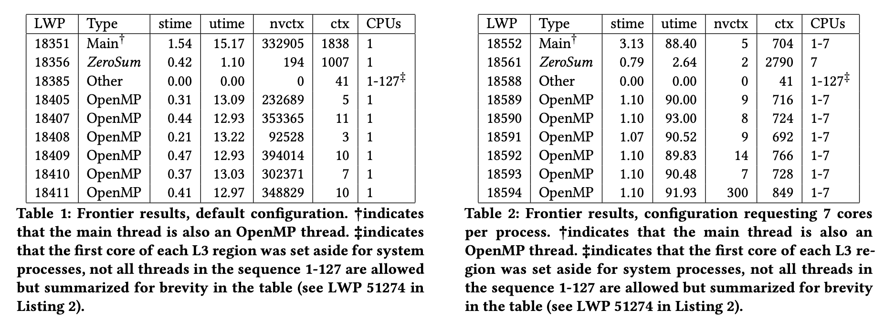
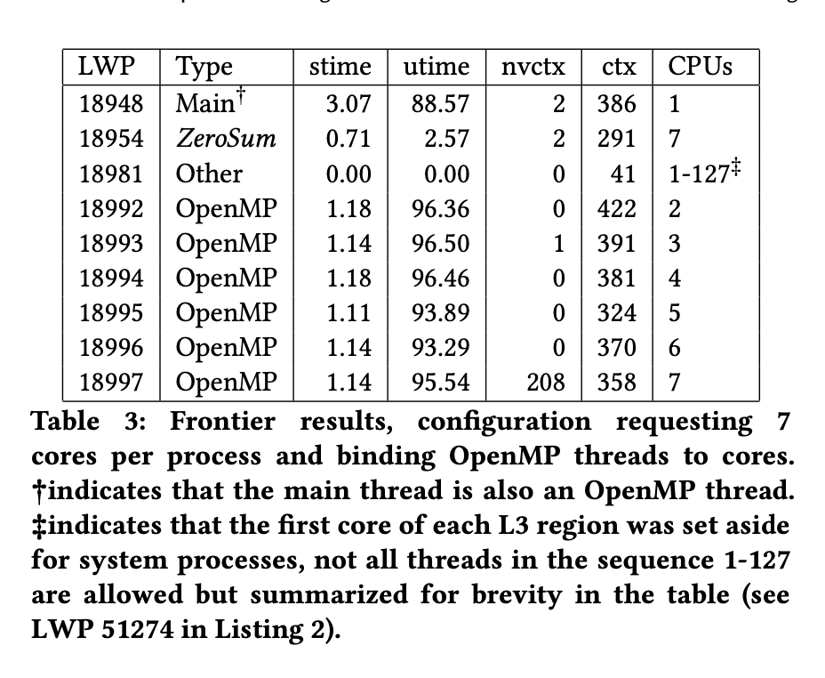
Evaluation / Example usage
MPI+OpenMP version of miniQMC on Frontier, 8 processes, 7 threads (64 cores, 1 thread per core, 8 cores reserved)
export OMP_NUM_THREADS=7
srun -n8 zerosum-mpi miniqmc
export OMP_NUM_THREADS=7
export OMP_PROC_BIND=spread
export OMP_PLACES=cores
srun -n8 –c7 zerosum-mpi miniqmc
export OMP_NUM_THREADS=7
srun -n8 –c7 zerosum-mpi miniqmc
Note: stime/utime reported as % of total time
Notes:
This is an example from the HUST paper

Slide 9
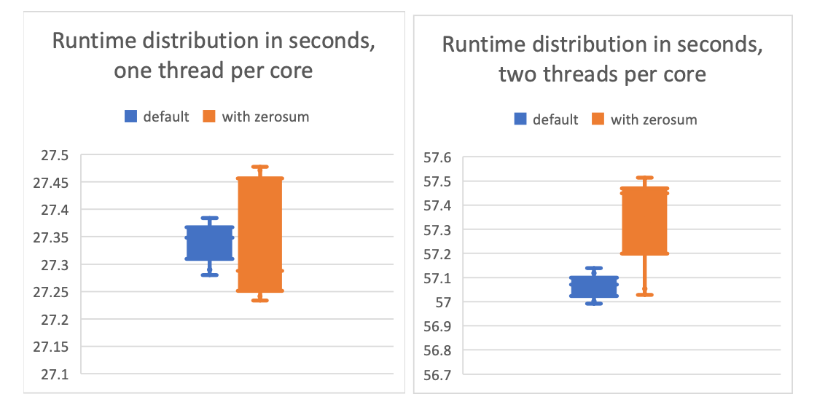
Overhead – less than 0.5% in resource constrained example
miniQMC time distributions executed 10 times using one OpenMP thread per core (left). In this comparison, the distribution of times with ZeroSum is noisier, but there is no significant observation of measurable overhead. The right figure shows the time distributions using two OpenMP threads per core. In this comparison, the distribution of times with ZeroSum is both noisier and longer tailed, and does show an observation of overhead, averaging about 0.2752 seconds, or 0.5%.
Notes:
Only one miniapp on one system, but should be representative.

Slide 10
Summary views of collected data – 64 GCDs, XGC running on Frontier
Notes:
Let’s look at time-series data from GPUs… apologies for the small font. This shows min/mean/max and .25 and .75 quartiles across all ranks

Slide 11
Summary views of collected data – 896 HWTs, XGC running on Frontier
↙️ All hardware threads from all ranks ↘️
↖️ Only main hardware thread from all ranks ↗️
Notes:
Averaging all 17 threads drags the means. However, looking at just main threads allows comparisons across ranks. Also, what's going on with the system times at exit?

Slide 12
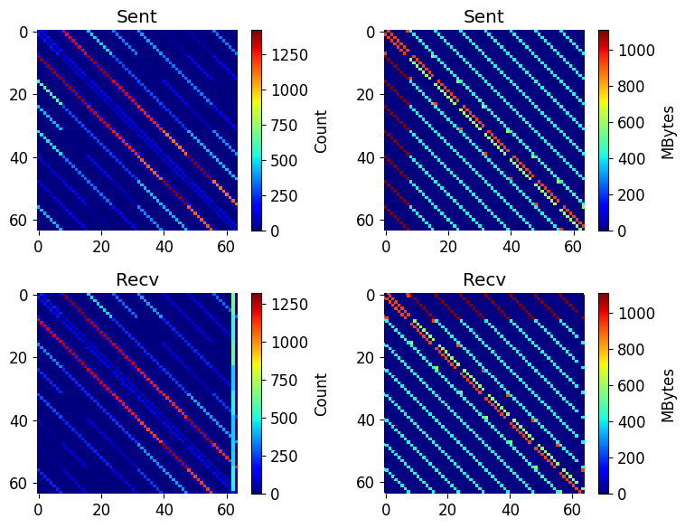
MPI P2P data
MPI implementation includes wrappers for MPI_Recv/Irecv, MPI_Sendrecv, MPI_Send/Bsend/Isend/ Rsend/Ssend to capture P2P frequency, volume
Obviously can be done by other/better performance measurement tools, but for a quick view, can be useful

Slide 13
Successful Use Cases
Octo-Tiger (HPX) thread placement on Fugaku
  Detected unusual core indexing, needs to be mapped using hwloc information
Argobots example
  Detected that the user was running client & server on same node with overlapping affinity lists
Grid (https://github.com/paboyle/Grid) on Frontier (lattice QCD library)
  Helped find/understand ideal resource mapping with custom bind arguments
XGC on Frontier
  Empirically demonstrated that 2 threads per core provided better performance than 1 thread per core
  Helped detect deadlock in GPU-aware libfabric/MPI implementation
  Helped detect algorithmic deadlock in MPI (application bug)
Notes:
For some weird systems (Fugaku), the first core is logically 0 but the OS sees it as 12. So there are 48 cores with logical indexes 0-47, but the OS reports them as 12-59. We need to map them so that we monitor the right CPU HWT from /proc/stat. Christopher Kelly at BNL did the Grid mapping work.

Slide 14
Deadlock detection – at scale
Runs application in gdb/cuda-gdb/rocgdb/gdb-oneapi in “batch” mode – sequence of commands are scripted
ZeroSum monitors all threads during execution:
  If all sleeping for X seconds (X is user-configurable):
    pthread_kill(SIGQUIT) the main thread
  If all but 1 sleeping for X seconds, and that thread doesn’t have at least one minor page fault during that time, it’s probably deadlocked at an MPI collective:
    pthread_kill(SIGQUIT) the main thread
Gdb will intercept the signal and is scripted to get a backtrace from all threads
Post-process the threads and make a tree (just like STAT/Cray-STAT)
  However, ZeroSum is automated - queue times on Perlmutter were around 8 hours, user didn’t want to babysit the slurm request

Slide 15
Example: XGC deadlocked on Perlmutter with 512 ranks
Only 52 of 64 in communicator participated in collective

Slide 16
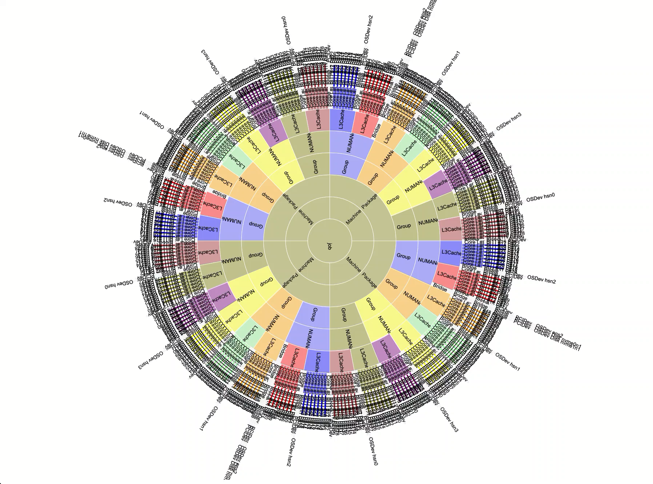
HWLOC integration with utilization data
32 rank, 4 node job on Frontier
14 threads per process, color coded by shmrank (local rank per node)
Segment color intensity relative to utilization
Validates that process threads are pinned where requested

Slide 17
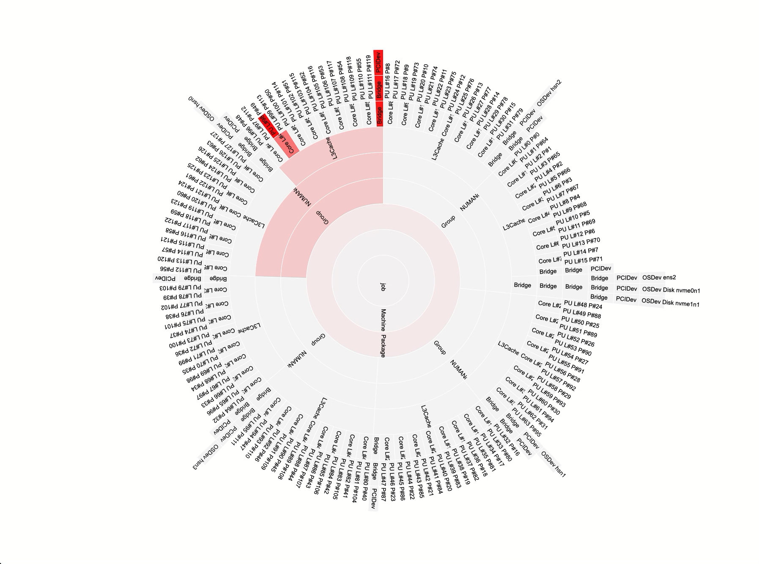
HWLOC integration with utilization data – GPU data
1 rank, 1 node Kokkos test on Frontier
1 GPU
Utilization data from ROCm-SMI mapped to device using PCI Bus ID
Segment color intensity relative to utilization
Validates that the process got the correct GPU (same L3 Cache region)

Slide 18



Acknowledgements
This work was supported by the Scientific Discovery through Advanced Computing (SciDAC) program funded by U.S. Department of Energy, Office of Science, Advanced Scientific Computing Research (ASCR) under contract DE-SC0021299.
Parts of this research was supported by the Exascale Computing Project (17-SC-20-SC), a joint project of the U.S. Department of Energy’s Office of Science and National Nuclear Security Administration, responsible for delivering a capable exascale ecosystem, including software, applications, and hardware technology, to support the nation’s exascale computing imperative.
This research used resources of the Oak Ridge Leadership Computing Facility at the Oak Ridge National Laboratory, which is supported by the Office of Science of the U.S. Department of Energy under Contract No. DE-AC05-00OR22725.

