Slide 1



APEX: Recent Work
(Autonomic Performance Environment for eXascale)
Kevin Huck, Mohammad Alaul Haque Monil,
Allen D. Malony
http://github.com/khuck/xpress-apex
http://stellar-group.org/libraries/hpx/

Slide 2
What is APEX?
Performance measurement library for distributed, asynchronous tasking models/runtimes
  i.e. HPX, but there are others
  Lightweight measurement (tasks <1ms)
  High concurrency (both OS threads and tasks in flight)
  Distinction between OS and runtime (HPX) thread context
  Lack of a traditional call stack
    Task dependency chain instead
  Runtime controlled task switching
Infrastructure for dynamic feedback and control of both the runtime and the application
Notes:
Point of this slide: introduce the motivation for the APEX project. Why was it first funded under the XPRESS project?
APEX was originally designed as a performance measurement library for distributed Asynchronous Tasking Runtimes - specifically HPX. Some of the challenges include:
Lightweight measurement (tasks <1ms) – all libraries want low overhead, but HPX tasks are “ideally” in the ~10ms size, but can be much smaller
Thread safety – all libraries require thread safety, but high concurrency demands no shared data between measurement threads
Distinction between OS threads and HPX threads – sampling techniques rely on the OS thread context. (i.e. callstack). But tasks yield, migrate, resume – OS context is meaningless.
Lack of a meaningful callstack – with the exception of “direct actions”, HPX tasks create other tasks, everything is queued and scheduled to run when possible. The task dependency chain is much more meaningful in HPX.
Runtime controlled task switching – when task dependencies aren’t met, the task yields and resumes when they are met – usually on another CPU core/OS thread, possibly another node (locality) in the allocation.
Dynamic runtime control – key requirement – the measurement system is in service of runtime feedback and control.

Slide 3
APEX Measurement
Top down (application) and bottom up (OS/HW) performance mapping / feedback
  Make node-wide resource utilization data and analysis, energy consumption, and health information available in real time
  Associate performance state with policies for feedback control
APEX introspection
  OS: track system resources, utilization, job contention, overhead
  Runtime (HPX): track threads, queues, concurrency, remote operations, parcels, memory management
  Application timer / counter observation
Post-mortem performance analysis
Integrated with HPX performance counters

Slide 4
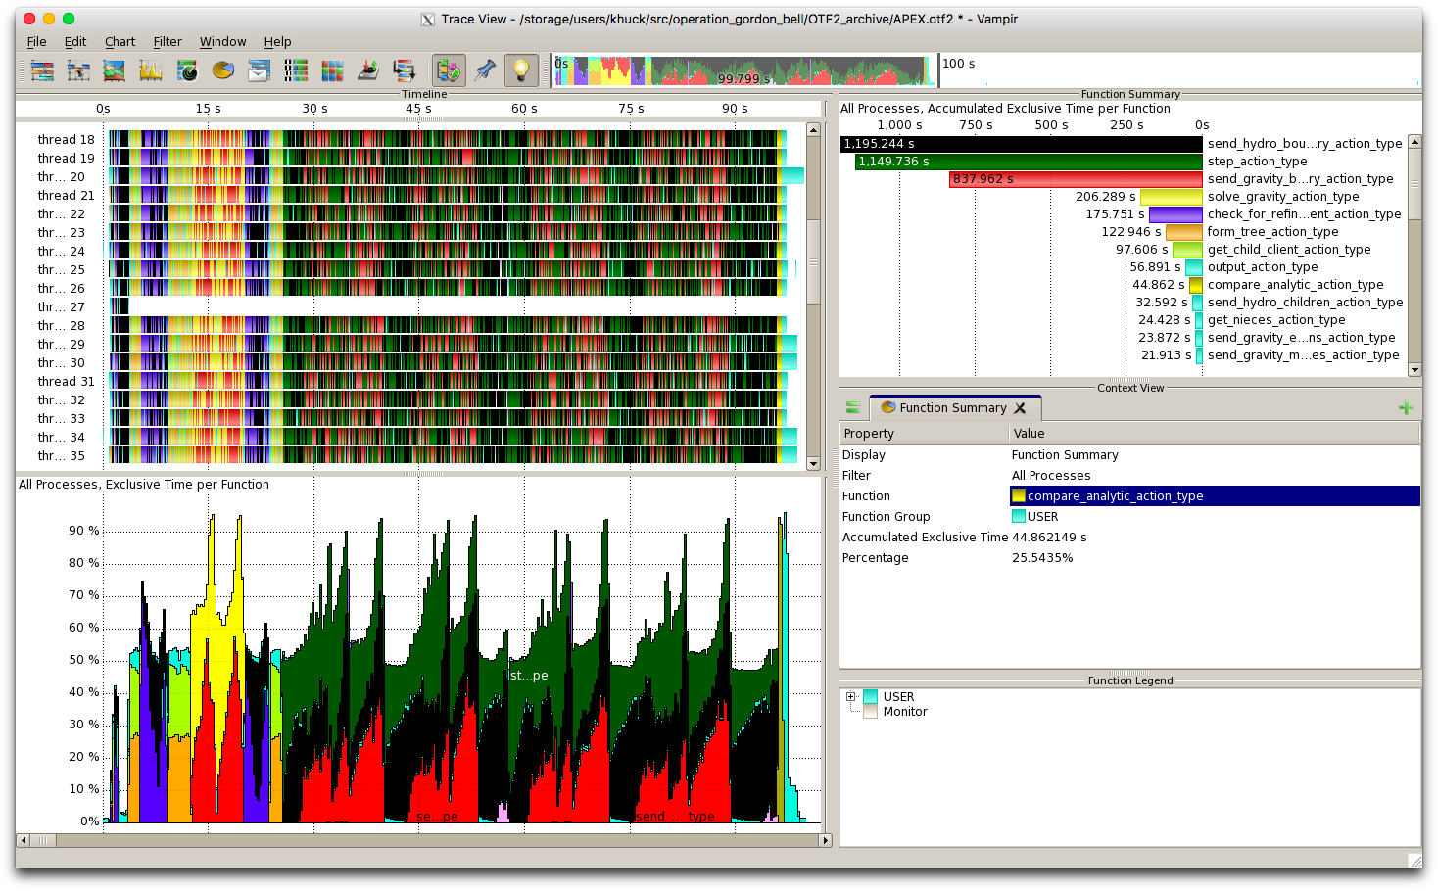
APEX Architecture
APEX Introspection
Synchronous
Asynchronous
events
System Info
(/proc, getrusage, LM Sensors, etc.)
Application
meta-events
APEX State
HPX
APEX Policy Engine
Triggered
Periodic
actuators
Notes:
This is a graphical representation of the APEX architecture.
The application and HPX are sending synchronous events through the APEX API to the synchronous Introspection layer.
In addition, APEX is asynchronously measuring the OS, hardware, etc. to monitor node “health”.
The APEX performance state is asynchronously updated by processing the performance measurements.
The policy engine monitors the performance state, and executes policies that potentially modify runtime and/or application behavior.
The APEX state is optionally written to disk for post-mortem analysis, either as TAU profiles, OTF2 traces, CSV, or other forms of output.

Slide 5
APEX Introspection
APEX collects data through “inspectors”
  Synchronous uses an event API and event “listeners”
    Initialize, terminate, new thread – added to HPX runtime
    Timer start, stop, yield*, resume* – integrated into HPX task scheduler
    Custom events (meta-events)
  Asynchronous do not rely on events, but occur periodically
    Sampled values (counters from HPX)
APEX exploits access to performance data from lower stack components
  “Health” data through other interfaces (/proc/stat, /proc/cpuinfo, /proc/meminfo, /proc/net/dev, /proc/self/status, lm_sensors, power*, PAPI hardware counters, etc.)

Slide 6
APEX Policy Listener
Policies are rules that decide on outcomes based on observed state
  Triggered policies are invoked by introspection API events
  Periodic policies are run periodically on asynchronous thread
Polices are registered with the Policy Engine
  Applications, runtimes, and/or OS register callback functions
Callback functions define the policy rules
  “If x < y then…” – any arbitrary logic
Enables runtime adaptation using introspection data
  Feedback and control mechanism
  Engages actuators across stack layers
  Could also be used to involve online auto-tuning/online-search support
    Active Harmony http://www.dyninst.org/harmony
    Hill climbing, etc.
    Control theory (e.g. concurrency)

Slide 7
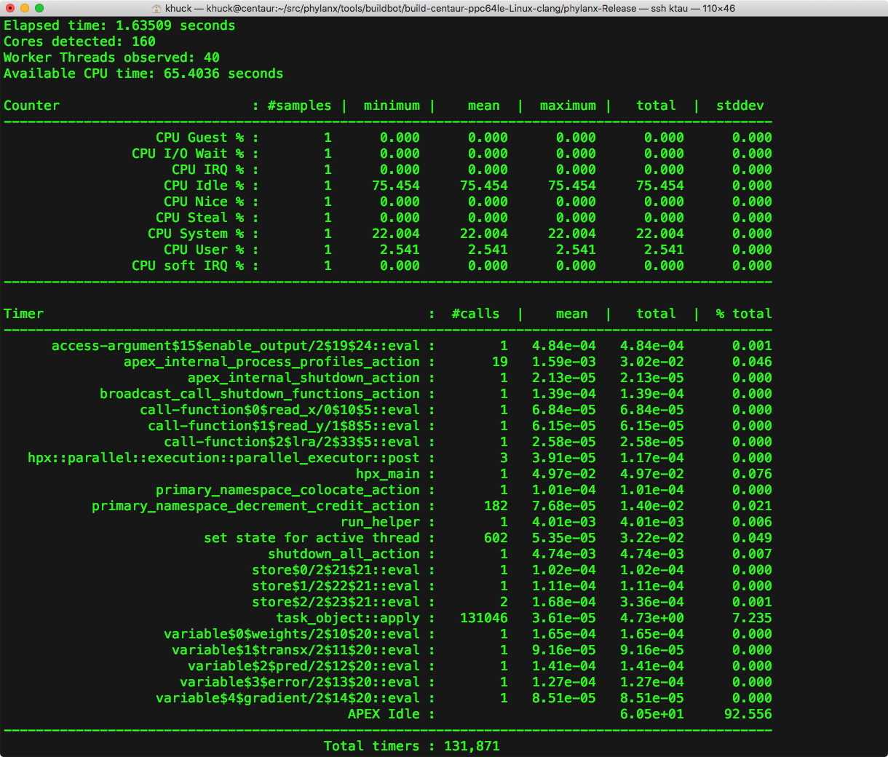
Screen Output
APEX, HPX counters
APEX timers

Slide 8
Concurrency View
Notes:
This shows the Octotiger application running on 1000 nodes of Cori (68k cores), before the grid partitioning was optimized

Slide 9
Concurrency View
Notes:
This shows the Octotiger application running on 1000 nodes of Cori (68k cores), after the grid partitioning was optimized

Slide 10
OTF2 View in Vampir
Notes:
Octotiger

Slide 11
ARCS: Adaptive Runtime Configuration Selection
Power aware computing – optimizing OpenMP parameters per parallel region based on available resources (power, cores, etc.)
APEX autotuning policy to search for best:
  Number of threads in the team
  Scheduling policy
  Chunk size
APEX uses OMPT, Active Harmony to configure & measure each executed instance of each parallel region until convergence

Slide 12
ARCS workflow, results
Offline
Online
Application
New Kernel
Pick a configuration
Run, Measure, Select optimal configuration for each kernel
Corresponds to one online run
NO
Run the kernel with this configuration
Performance Data
Write the configurations in a history file
Converged?
Y
From Next Run
Use this configuration from now on
Use the configuration form History file
Complete Application & write the configuration in history File
Notes:
Search strategy is why offline is slower than online - Rhs_norm, error_norm, initialize, exact_rhs, print_results (5) kernels did not converge
SP execution time graph across all power caps
Data set B
Intel Sandybridge

Slide 13
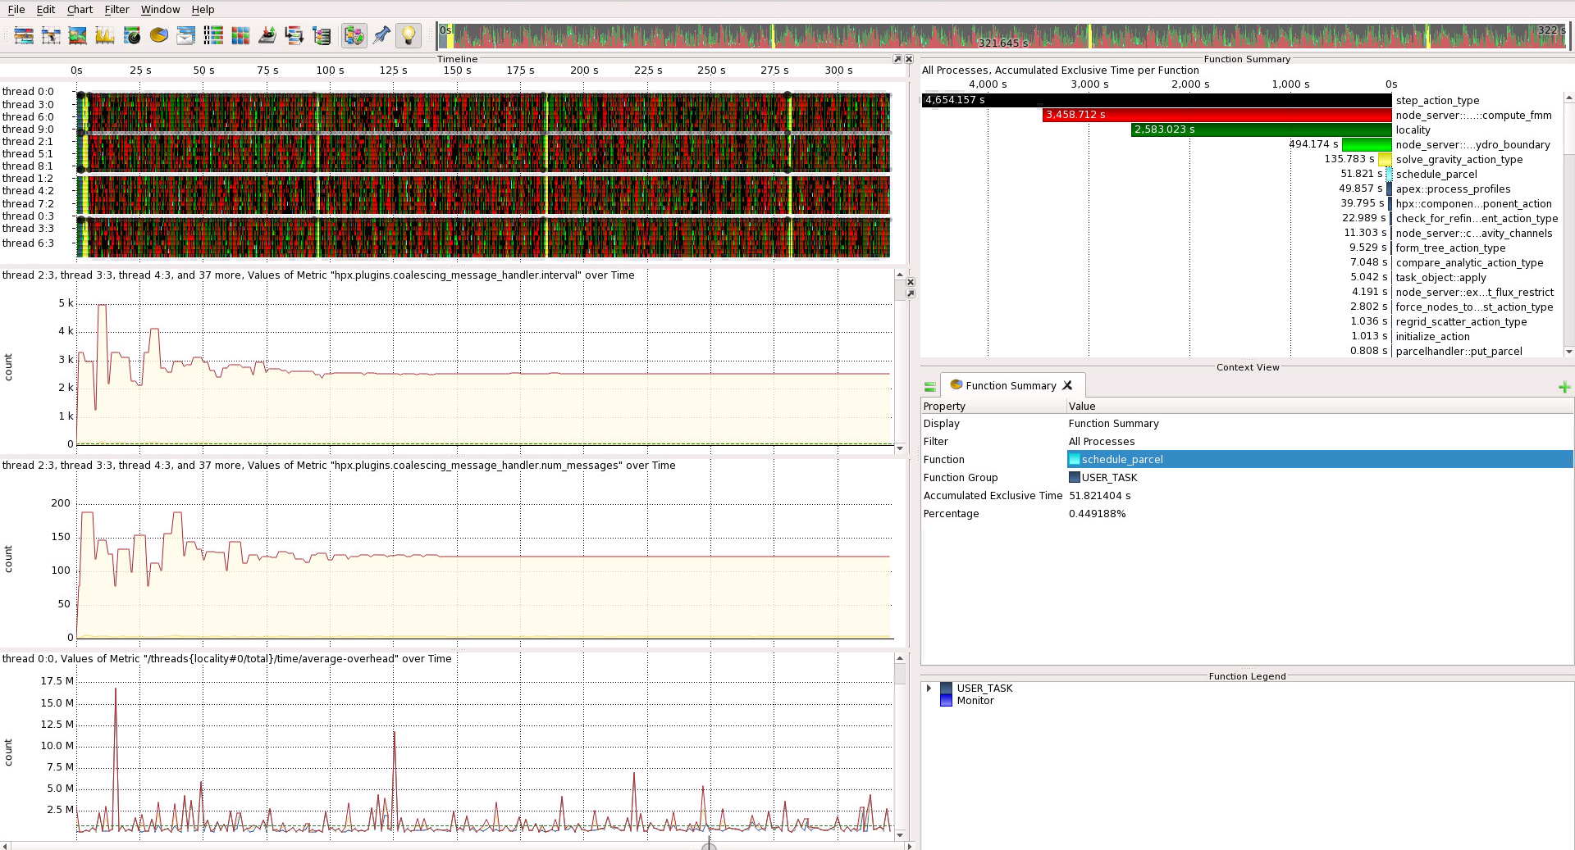
HPX Policy Example: Parcel Coalescing
Notes:
This shows the octotiger application running on Talapas using a parcel coalescing policy. Rather than send every individual P2P message between nodes, messages are queued until the queue depth is reached or a timeout. This policy tunes those two parameters, the queue depth and the timeout. This work is being updated in APEX/HPX to use a different response variable to tune with.

Slide 14
Taskgraph Views
High-level view of task dependency relationships (task types, not individuals)

Slide 15
Task dependency analysis
Resurrecting previous work performed by extending OTF2 and building custom analysis and viewer
Current OTF2 modifications: adding task GUID and parent GUID attributes to timer events captures dependencies
Ravel trace viewer being rewritten as Traveler (tasking Ravel) – web browser-based tool
Add critical path/bottleneck analysis algorithm to Traveler

Slide 16
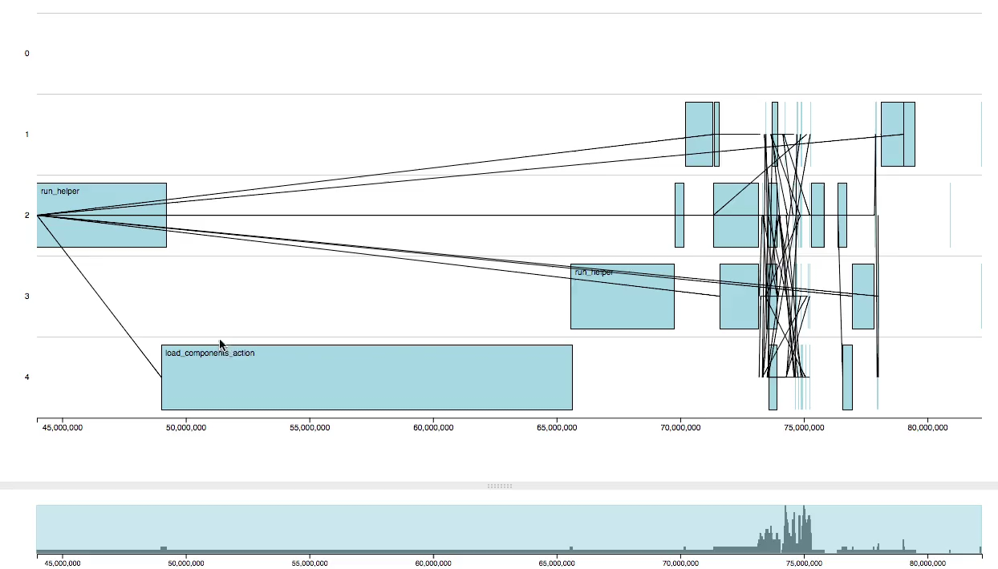
Task dependency in new viewer - Traveler
Notes:
Fibonacci computation from HPX, using 4 threads. This video shows a short session interacting with the new viewer from Arizona. Zooming in/out, scrolling, selecting tasks and seeing its dependencies and children.

Slide 17



MONA: Monitoring and Analytics
Kevin Huck, Chad Wood,
Allen D. Malony

Slide 18
Monitoring and Analytics
Project goal – develop and demonstrate infrastructure for monitoring coupled scientific applications on HPC resources and analyzing results both offline and online
  Tightly integrated applications (interaction libraries)
  Loosely integrated applications (autonomous applications)
  Scientific workflows / pipelines
Expand “context” of HPC execution beyond myopic view of 1 mpirun instance

Slide 19
MONA General Use Case
Applications integrated using staged I/O provided by Adaptable IO System (ADIOS)
ADIOS – “provides a simple, flexible way for scientists to describe the data in their code that may need to be written, read, or processed outside of the running simulation”
Multiple transports, from POSIX through RDMA
Applications exchange data at integration boundaries

Slide 20
MONA Technology
Tuning and Analysis Utilities (TAU)
Scalable Observation System (SOS)
ADIOS
EVPath
Analysis pipelines in C/C++, Python

Slide 21
Synthetic Benchmark Extraction
Goal: construct synthetic benchmark workflow from empirical data
Coupled workflow (GTS & FFT analysis coupled with ADIOS), measured by TAU
SOS extracts event trace
Event trace post-processed to JSON specification
JSON data used by Pooky to generate a “Pooklet” – application with MPI collectives, ADIOS calls, ”computational” regions
Pooklet used to model configuration scenarios
Coupled Applications
MPI, ADIOS
events
SOS
Code
Generation
Validation,
comparison
Synthetic Coupled Appliccations
SOS

Slide 22
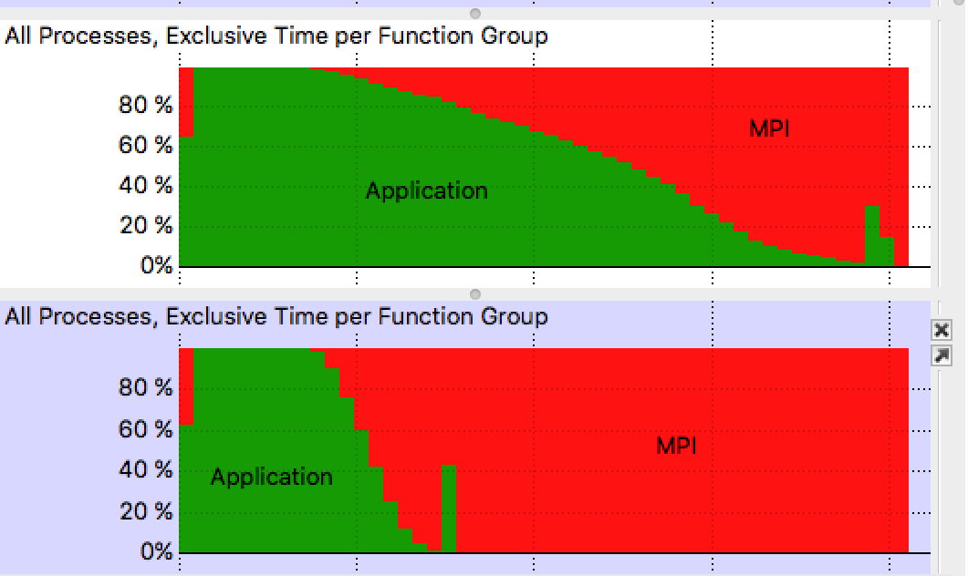
TGE for Topology Mapping
Task Graph Embedding
XGC & Gene coupled with ADIOS on Titan
Analyze inter- and intra-communication to determine ideal process mapping for non-contiguous allocations
TAU captures MPI P2P exchange data within applications, and ADIOS read/write data between applications
Analysis finds better mapping based on allocation diameter, discontinuities
Extension of work by Choi et al., “TGE: Machine Learning Based Task Graph Embedding for Large-Scale Topology Mapping”, Cluster Computing (CLUSTER), 2017 IEEE International Conference on, 587-591
An instance of 1,040 node allocation on Titan with Cray Gemini interconnect
(3D Torus of size 25x16x24)
Before
(Default)
After
Task Graph
Mapping
Notes:
The figures and results are from Jong Choi’s previous work. The new work uses TAU for MPI, ADIOS measurement, and SOS to aggregate all data in one location.

Slide 23
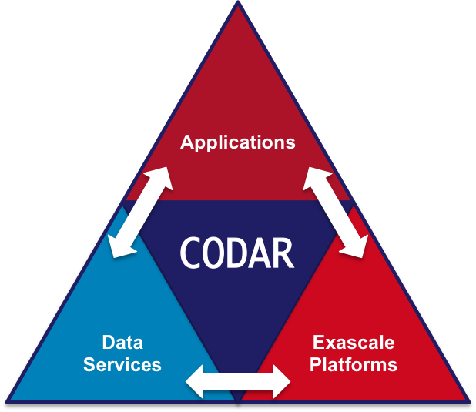

CODAR – CoDesign (ECP)
Notes:
Principal Investigators: Ian Foster, lead, Argonne National Laboratory (ANL); Scott Klasky, Oak Ridge National Laboratory; Kerstin Kleese van Dam, Brookhaven National Laboratory; Todd Munson, ANL

Slide 24
CODAR overview
Co-Design Center for Online Data Analysis and Reduction at the Exascale is addressing the growing disparity between simulation speeds and I/O rates rendering it infeasible for high-performance computing and data analytic applications to perform offline analysis. The center is targeting common data analysis and reduction methods (e.g., feature and outlier detection, compression) and methods specific to particular data types and domains (e.g., particles, FEM). It aims to reduce application development risk by providing performance tradeoffs for offline vs online analyses of simulation results, and produce and integrate into applications high-performance products that embody data analysis and reduction methods.
source: https://www.exascaleproject.org/project/codar-co-design-center-online-data-analysis-reduction-exascale/
Notes:
Need to bulletize this

Slide 25
SOS: Scalable Observation System
SOSflow is a Scalable Observation System providing monitoring support for introspection, in situ analytics, and application steering
Programmable runtime service
  Workflow-focused
  MUNGE authentication support
  Runs entirely in user space
  C/C++, Python API for online data queries
Local and aggregate storage / staging of data
TCP/IP sockets on node, EVPath between nodes
Led by Chad Wood (UO)
http://github.com/cdwdirect/sos_flow

Slide 26
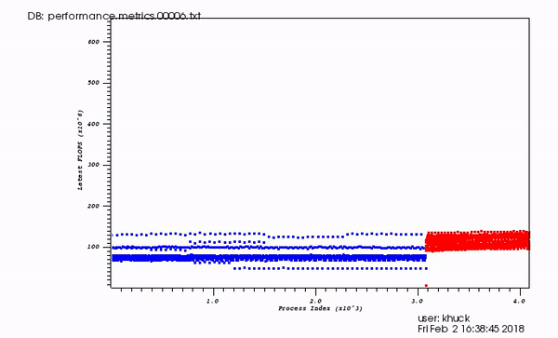
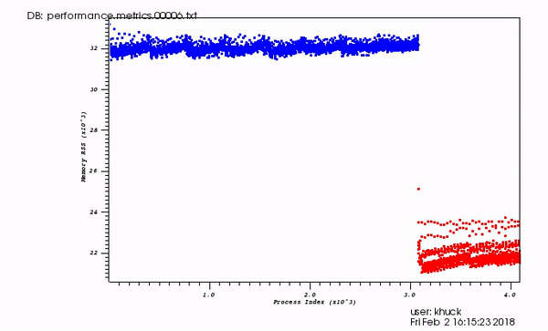
SOS in CODAR Collaboration
SOS plugin integrated into TAU
Callback API added to ADIOS for runtime tool integration
  2 tool implementations, default and TAU
TAU profile data pushed over SOS periodically or at specific ADIOS events
  Configurable
  TAU profile data pushed over SOS at variable granularities
SOS aggregation databases can be queried at runtime or post-mortem
  SQL queries
  Python & C APIs for runtime data analysis – VTK, ADIOS, CSV outputs
  “fast cache” data access for streaming data
Realtime dashboard views of FLOPs, memory usage in coupled XGC/GENE simulation on Titan
Notes:
Trace collection used by ADIOS project for synthetic application generation

Slide 27
Engagements
Current: XGC/GENE
  Optimizations identified
  Publications to come
Future:
  NWChemEx
  QCD
  LAMMPS

Slide 28
Coupled Application Trace Collection
Phase 1 – combine individual application traces together from coupled workflow postmortem for visualization, analysis
Phase 2 – collect and merge workflow application data at runtime
Perform anomaly detection using selective TAU/SOS trace
When “interesting” region detected, dump window of trace data leading up to event
”Performance Visualization for TAU Instrumented Scientific Workflows”, Xie et al., VISIGRAPP/IVAPP 2018
Coupled Applications
TAU event trace
SOS
ADIOS
Trace stream
ADIOS
Trace window
Triggers
Anomaly
detection
Notes:
Collaboration with BNL

