Slide 1


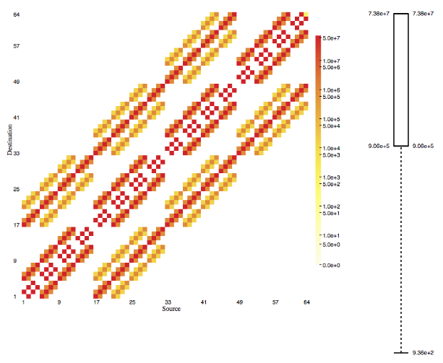
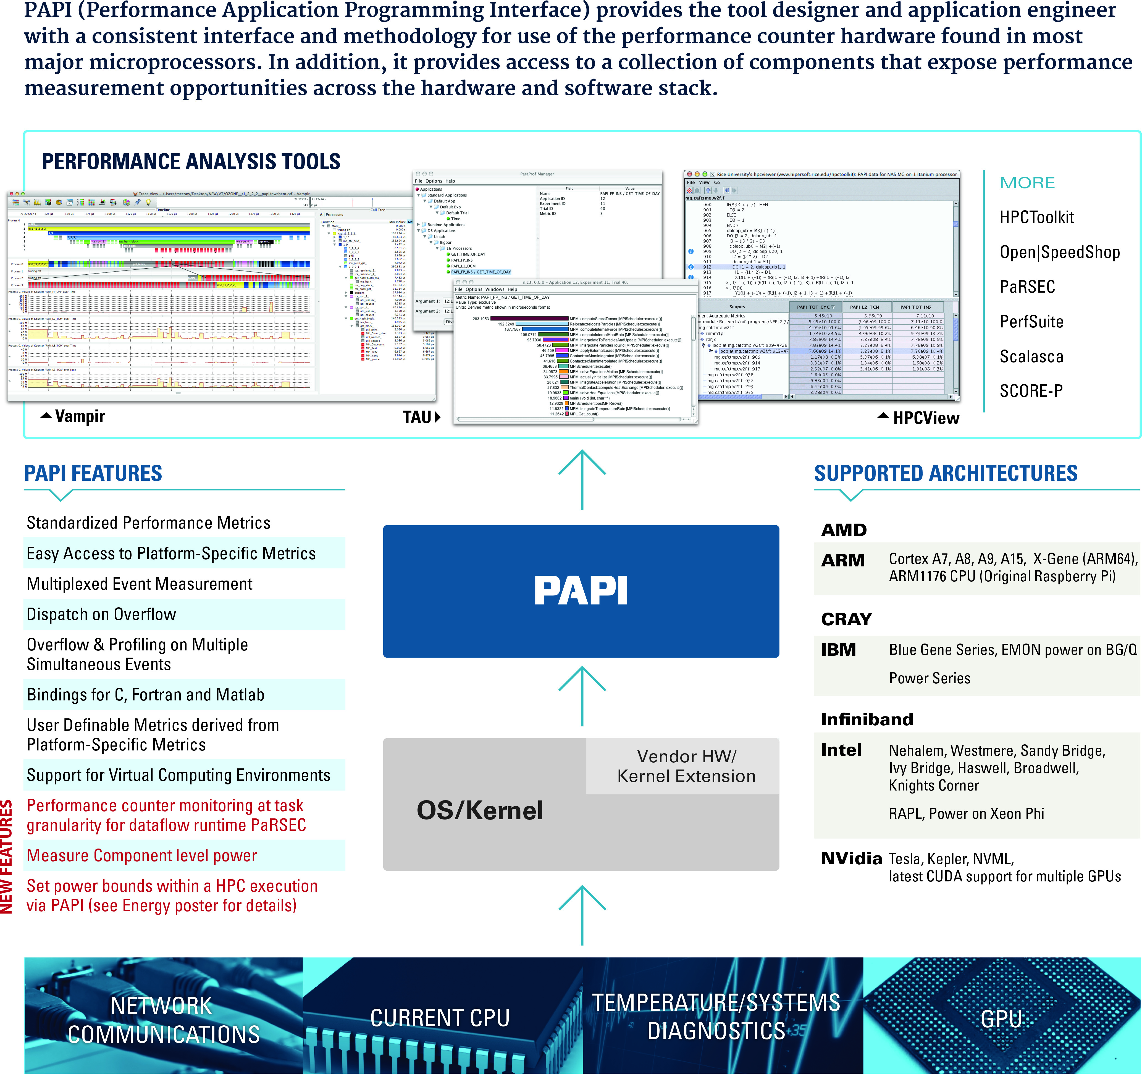

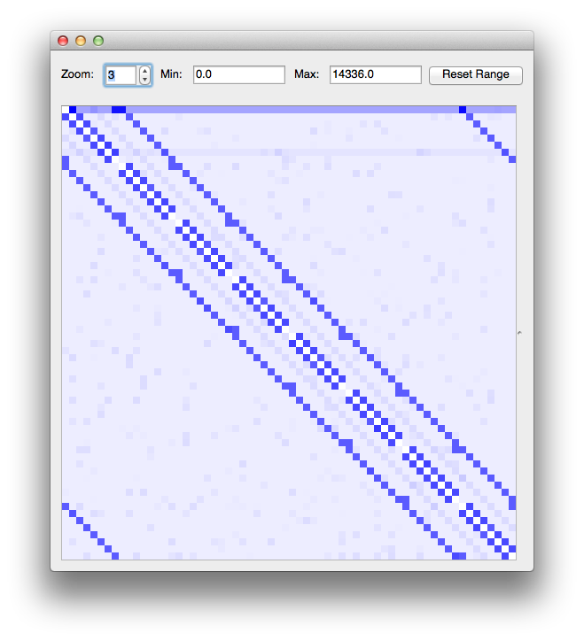
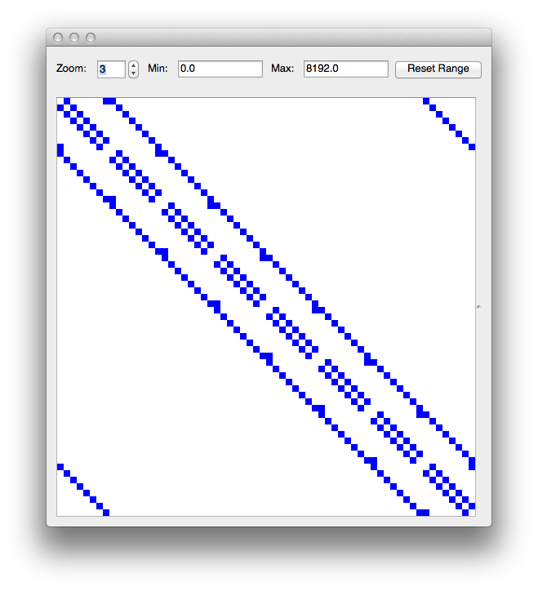
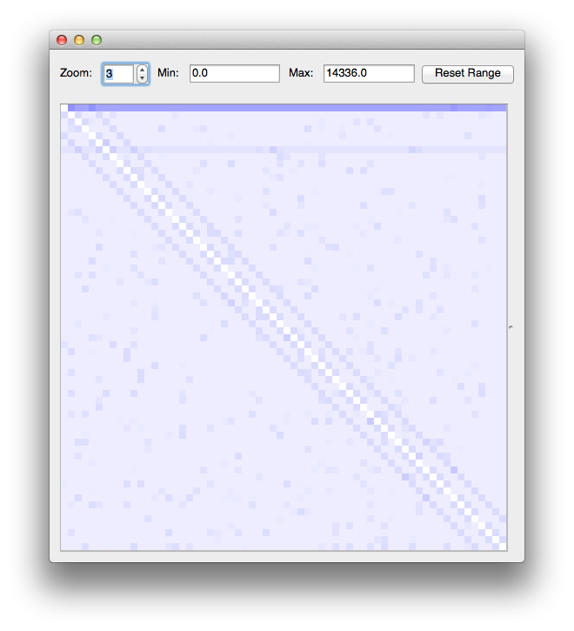
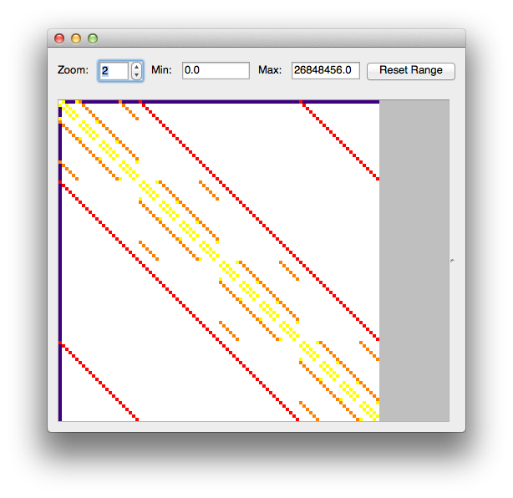
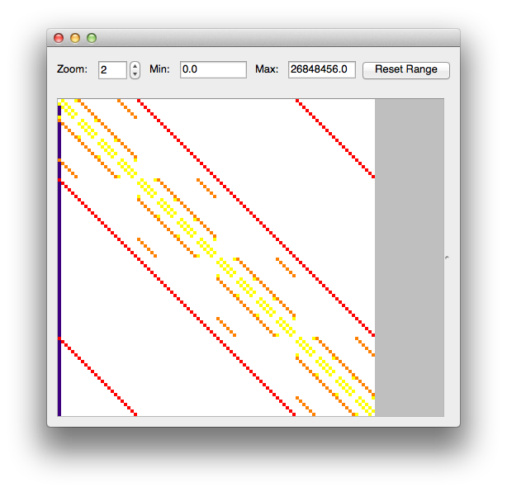
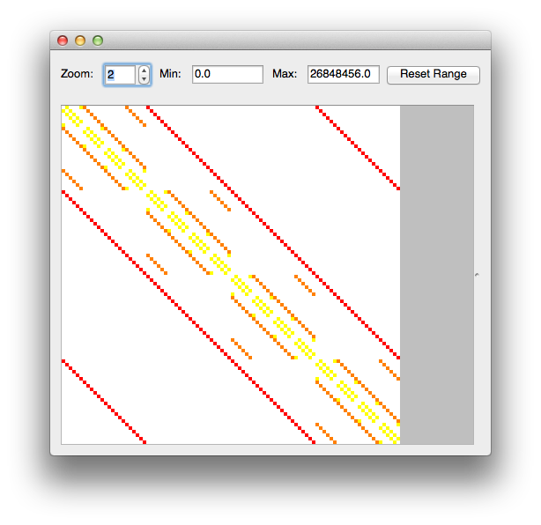
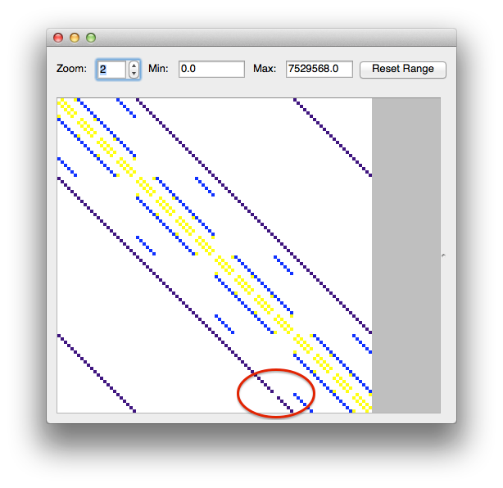



Technology Translation: Modeling, Measurement and Analysis
Philip C. Roth, Jeremy S. Meredith,
Jeffrey S. Vetter
Oak Ridge National Laboratory
Samuel Williams, Brian Van Straalen, Terry Ligocki,
Leonid Oliker, Matt Cordery, Nick Wright
Lawrence Berkeley National Lab
Yu Jung (Linda) Lo
University of Utah
Wyatt Spear, Boyana Norris
University of Oregon
Heike McCraw, Asim Yarkhan,
Sangamesh Ragate
University of Tennesee
Automated Characterization of Message Passing Application Communication Patterns
Performance API – PAPI
Empirical Roofline Toolkit
The Problem
  We want a concise way to express application communication demands
  E.g., “3D Nearest Neighbor, broadcast, and reduce” instead of communication matrices
  But…strong expertise needed to identify patterns from communication matrices
  Our Approach
  Automated search using a library of patterns to identify collection of parameterized patterns that best explains observed communication
  Adopts idea from astronomy’s sky subtraction: given an image, remove the known to make it easier to identify the unknown
PAPI (Performance Application Programming Interface) provides the tool designer and application engineer with a consistent interface and methodology for use of the performance counter hardware found in most major microprocessors. In addition, it provides access to a collection of components that expose performance measurement opportunities across the hardware and software stack.
Background
  The Roofline model provides a visually-intuitive approach to analyzing application performance.
    Decomposes application into key
    numerical kernels.
    Roofline is principally oriented around
    throughput metrics (flop/s vs. GB/s)
    Use machine and application balance
    to determine performance bound
    Expand by including ILP, DLP, TLP, cache,
    and memory access pattern effects
  To date, application of the Roofline has been challenged on four fronts…
    It requires a model of processor microarchitecture. Many researchers often lack the computer architecture background to create such a model.
    It requires accurate monitoring of kernel execution including DRAM data movement, SIMDization, ILP stalls, use of TLP, etc… This information is difficult to extract from some tools and impossible to gather from some processors.
    It requires estimates of the data movement and computational requirements of each numerical kernel. e.g. what is the minimum data movement and computation each kernel requires? Within each kernel, is there any inherent DLP or ILP? As often fail to extract these parameters, the model often requires application scientists be knowledgeable on both computer architecture and computer science (a rare combination).
    Visualization of the model was left to the user. In practice, this varied from whiteboard doodles, to elaborate GNU and MATLAB plots.
  To that end, SUPER and FastMath have collaborated on developing a Roofline Toolkit to facilitate its use.
Beyond the Textbook Roofline Model
Nominally, Roofline is a throughput-oriented (streaming) performance model on a single level of memory or cache.
In reality, architectures have multiple levels of memory and applications have hierarchical working sets.
Thus, reuse, bandwidth, and working set sizes are important metrics in understanding performance.
Expanded Roofline to capture performance on a two-level memory as a function of reuse and working set size…
    GPU performance is highly dependent on use of shared vs. cache (application writer must choose implementation on kernel by kernel basis).
    CPUs are much faster than GPUs in some regions…
  Input is communication matrix, e.g., as collected by the Oxbow version of mpiP (http://oxbow.ornl.gov)
  Each search step involves recognizing a pattern, scaling the recognized pattern as large as possible, and removing the scaled pattern to produce a communication matrix containing as-yet-unrecognized communication behavior
Recognizing and removing the contribution of a 2D nearest neighbor pattern in a synthetic communication matrix. This represents one step in a search-based approach.
-
=
Search Results Tree
  Communication matrices at nodes
    Initial communication matrix associated with tree root
  Recognized, parameterized patterns label edges
  Child node’s matrix is result of subtracting recognized pattern from parent’s matrix
  When child node is added to tree, recursively apply search starting at the child
Search results tree for synthetic communication matrix. Nodes are labeled with residual of associated communication matrix. Triangles indicate portions of the tree that are elided for space.
CUDA 6.5 now supports Unified Memory (treat device memory as OS-controlled page cache on CPU memory)
GPU Programmers must choose whether to…
  use Unified memory and let the OS control everything
  micromanage data allocation/movement/locality themselves
  use zero copy memory and keep everything on the host.
How does performance vary on Kepler GPUs (e.g. ORNL’s Titan and NERSC’s Dirac)?
  zero copy memory performs very poorly (PCIe bandwidth on every access) and has no benefit from temporal locality
  Page locked with explicit management works well for large working sets (>4MB) with high temporal locality (reuse 50x)
  Unified memory behaves like explicit management getting a benefit from temporal locality, but is 3x slower.
  It seems explicit management of data movement and locality is still required on Titan.
Initial ERT Release
  Initial ERT release focused on characterizing and visualizing the Flop/DRAM Roofline on CPU architectures.
    Peak flops (using polynomial amenable to FMA instructions)
    Bandwidths and Capacities for each level of memory and cache
  Proxy real-world applications…
    MPI+OpenMP implementation highlights any unintended NUMA issues.
    Compiled C code (can the compiler SIMDize?)
    Streaming (throughput-oriented) behavior with ample ILP, DLP, TLP
  Runs on…
    Xeon (Edison), Xeon Phi (Babbage), Opteron (Hopper)
    BlueGene/Q (Mira), Power7 and Power8
Output
  Residual of matrix is total amount of communication volume represented in matrix
  When search completes, path from root to leaf with smallest residual indicates collection of patterns that best explain original matrix (red path in example search results tree)
  Output from the automated search is a list of parameterized patterns that best explain input communication matrix
  Output is trivially converted into expression with parameterized patterns as terms, e.g.:
Original matrix
After removing broadcast
After removing reduce
After removing 3D nearest neighbor, dimensions (4,4,6), periodic
Example: LAMMPS
  Communication matrix collected using Oxbow’s mpiP for 96-process LAMMPS run of EAM benchmark on Keeneland Initial Delivery System
  Basically a 3D Nearest Neighbor pattern, but detected as imperfect (red circle in last figure)
Pilot implementation: Python-based using NumPy and SciPy matrix support
  Pattern recognizers/generators are Python classes
    Many-to-many, Broadcast, Reduce, 2D Nearest Neighbor, 3D Nearest Neighbor, 3D Wavefront (sweep) from a corner, Random (generate only)
(Partial) support for this work was provided through Scientific Discovery through Advanced Computing (SciDAC) program funded by U.S. Department of Energy, Office of Science, Advanced Scientific Computing Research (and Basic Energy Sciences/Biological and Environmental Research/High Energy Physics/Fusion Energy Sciences/Nuclear Physics). LLNL-POST-657319.
(Partial) support for this work was provided through Scientific Discovery through Advanced Computing (SciDAC) program funded by U.S. Department of Energy, Office of Science, Advanced Scientific Computing Research (and Basic Energy Sciences/Biological and Environmental Research/High Energy Physics/Fusion Energy Sciences/Nuclear Physics) under award numbers DE-SC0006844, DESC0006947.

