Slide 1

ZeroSum:
User Space Monitoring of Resource Utilization and Contention on Heterogeneous HPC Systems
Kevin A. Huck and Allen D. Malony
Oregon Advanced Computing Institute for Science and Society (OACISS)
https://tinyurl.com/hust23-zerosum

Slide 2
Performance Analysis Perspective on Monitoring
3 classes of performance optimizations:
Algorithmic replacement (usually a high level of difficulty)
  E.g. replace O(n²) with O(nlogn)
  Can involve data structure changes, new dependencies, major rewrites
Code optimization (usually a medium difficulty)
  Improve cache reuse, reduce stalls (branching, instructions, I/O, etc)
Optimized launch configuration (low difficulty)
  Misconfiguration
  Wrong assumptions from another system
  Changes to system policies/defaults (e.g. reserved cores)
  Low hanging fruit – but no purpose-built tool to assist (some ad-hoc solutions)
  Need for a user space monitoring solution

Slide 3
Motivation: Why do users monitor at runtime?
Sanity check / curiosity / impatience
Check for misconfiguration
Check for efficient utilization
Confirmation of expected hardware / operating system behavior
Identify cause of failure
Adaptation / computational steering / feedback & control
Identify system failures – out of scope
(Our foci today)
3

Slide 4
(Mis)Configuration
Process placement:
  logical/physical mappings, resources assigned/constrained to each process
  Reserved core(s) for system?
  GPU mapping
Thread placement: Socket, NUMA domain, core, thread (HWT)
Undersubscribing: Wasted hardware, energy, time (under-utilization)
Oversubscribing: Increased contention with no realized benefit (or worse, a penalty)
Imbalances (see process placement, above)
  What is the communication frequency/volume between pairwise ranks?
Let’s admit it: Slurm/PBS/Alps/Torque/Flux are complicated to use
  …especially when combined with MPI, OpenMP, GPUs, or other model settings

Slide 5
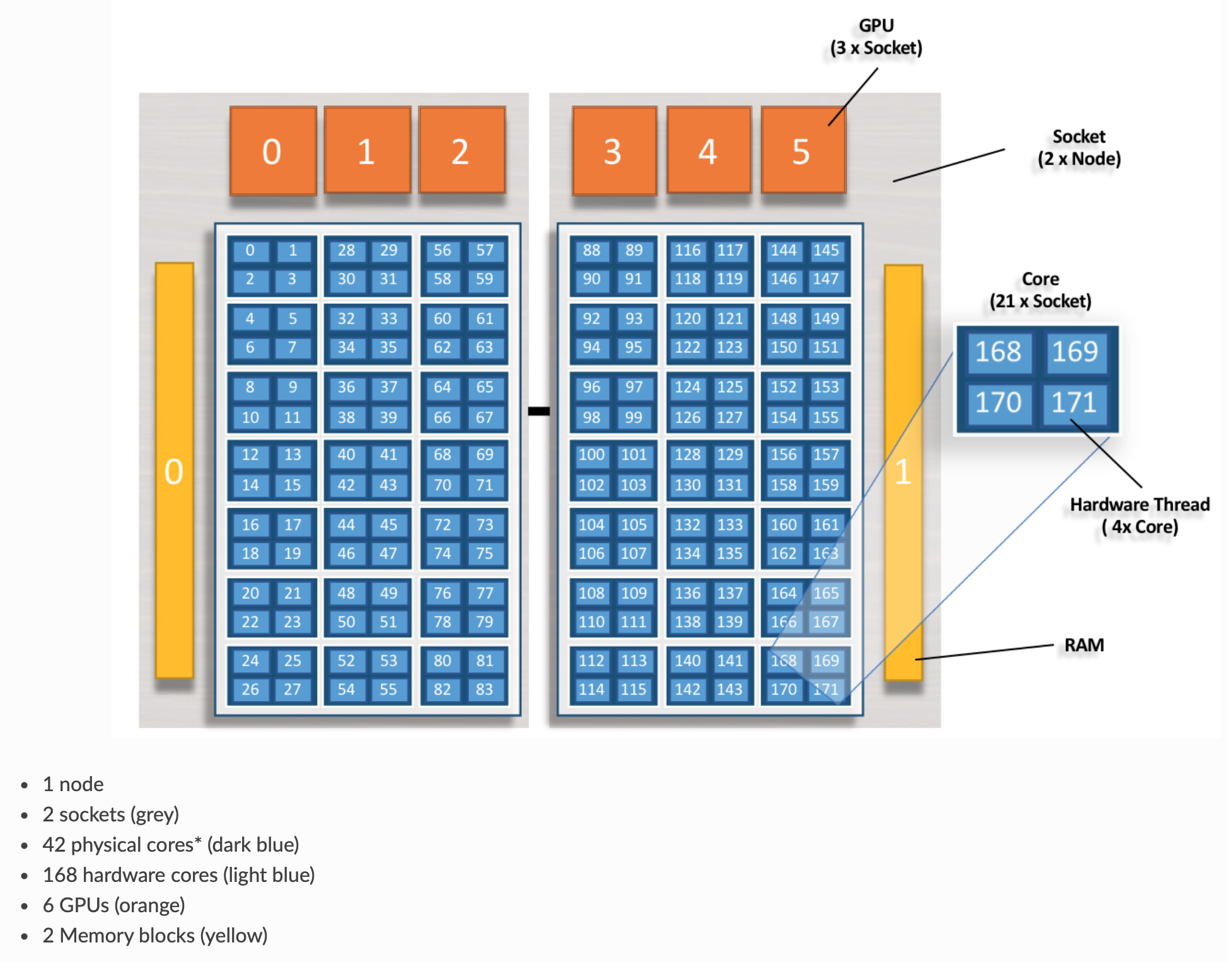
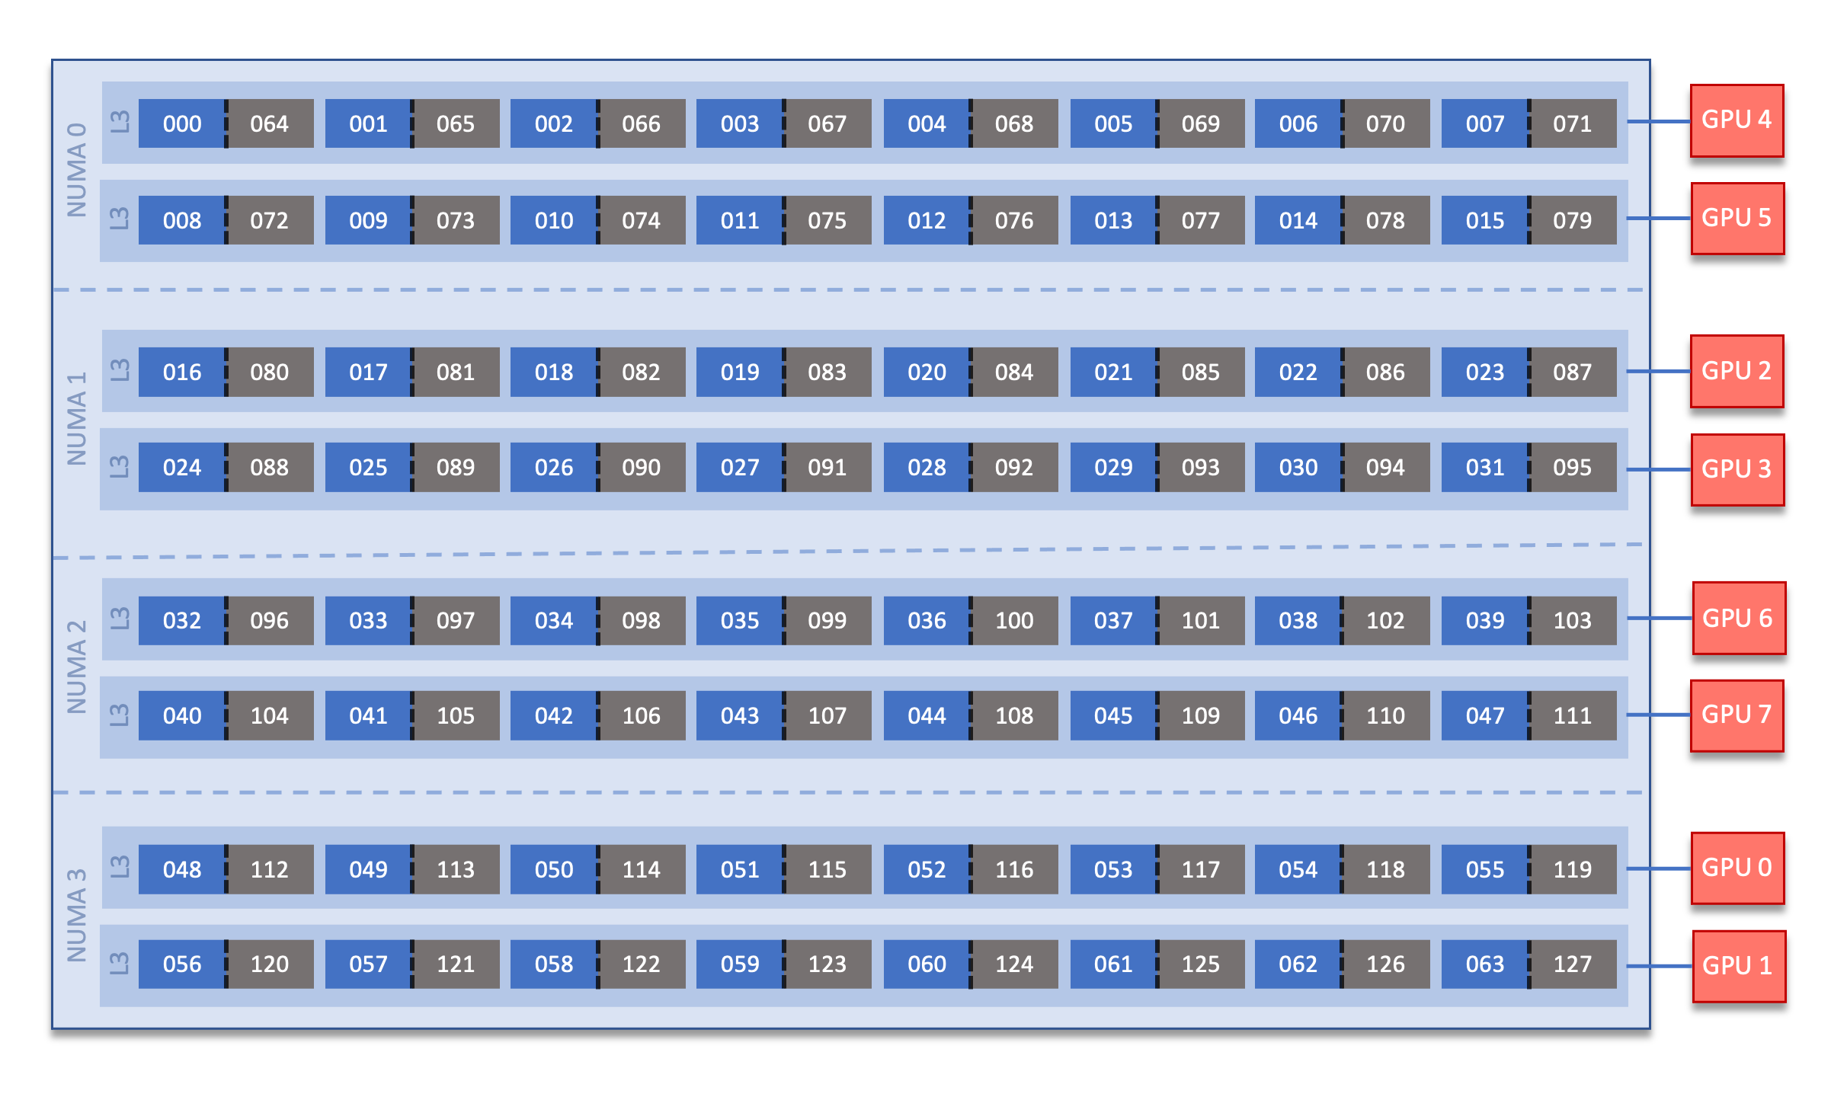
System documentation can be subtle/confusing, although accurate
Summit:
Frontier:
Core indexing, HWT indexing, GPU mapping not universal
Sources: https://docs.olcf.ornl.gov/systems/summit_user_guide.html ,
https://docs.olcf.ornl.gov/systems/frontier_user_guide.html

Slide 6
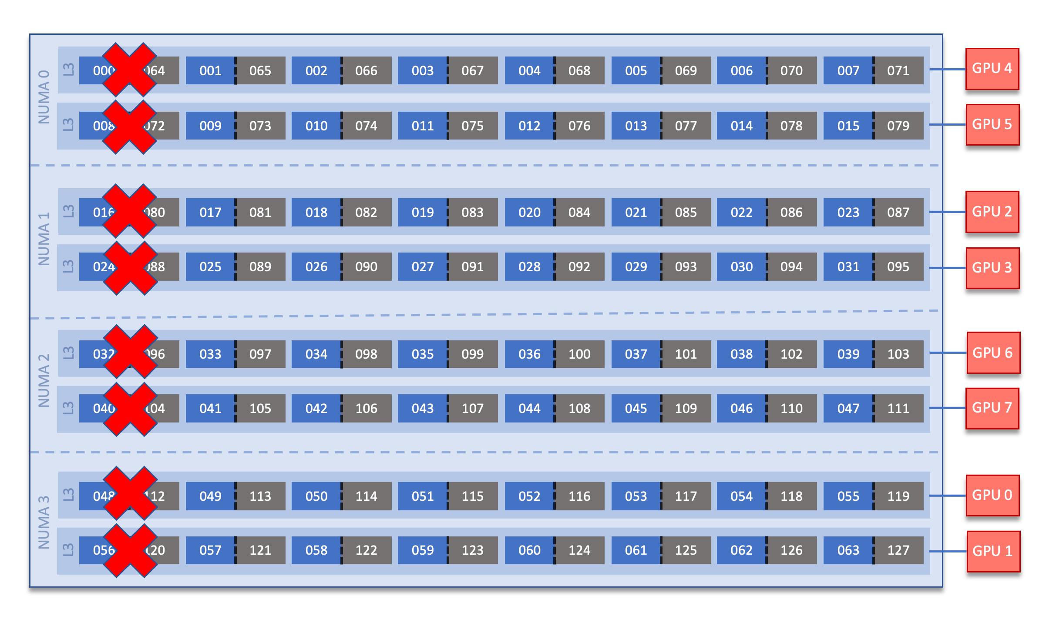
System documentation can be subtle/confusing, although accurate
Summit:
Frontier:
Modified default: system reserves 8 cores…but user controllable
Sources: https://docs.olcf.ornl.gov/systems/summit_user_guide.html ,
https://docs.olcf.ornl.gov/systems/frontier_user_guide.html

Slide 7
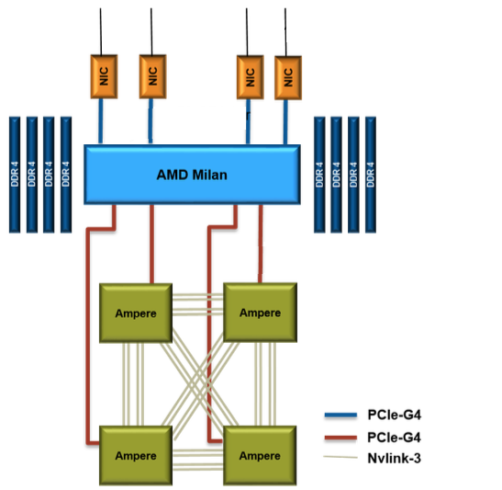
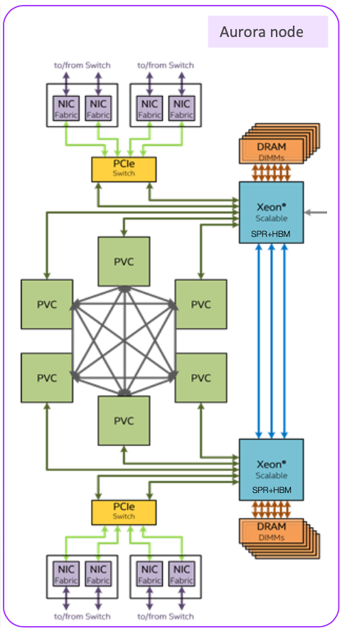
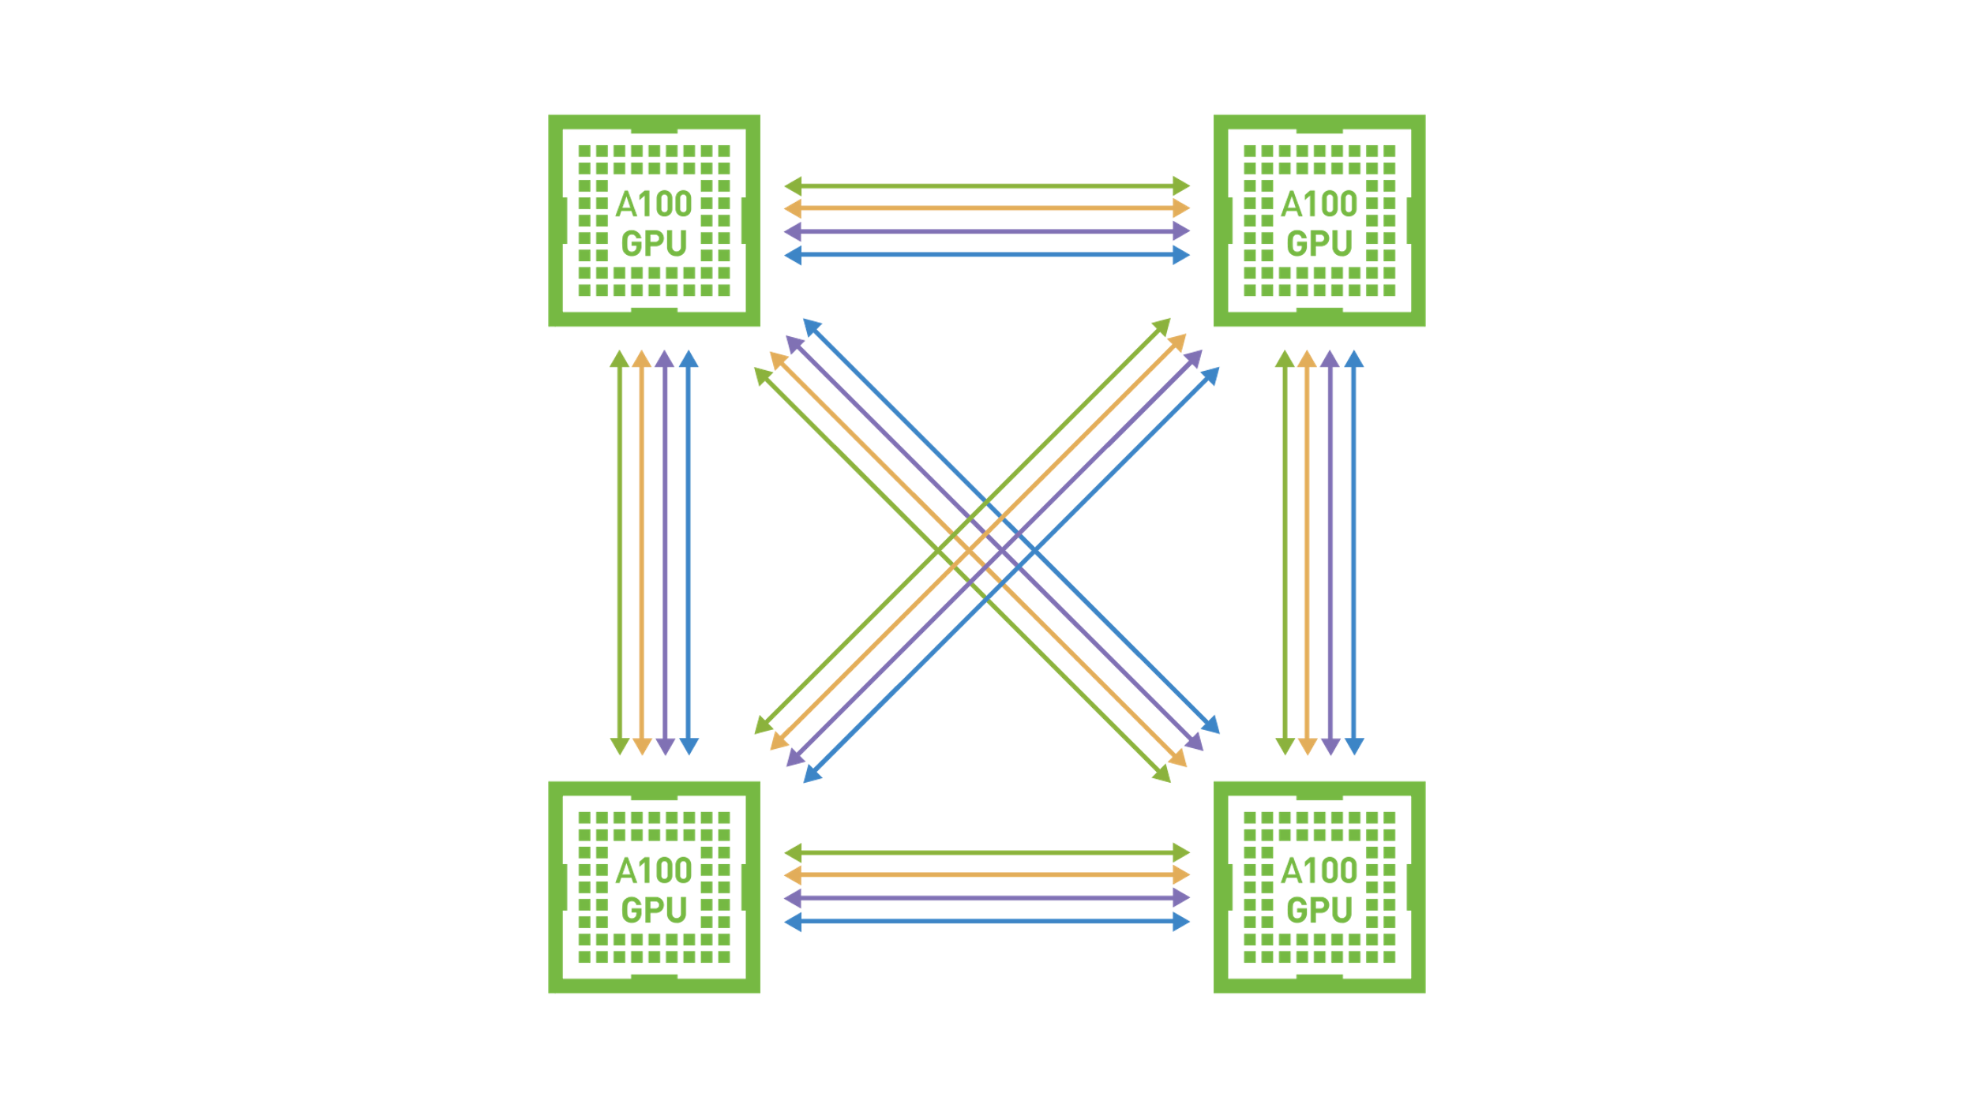
More systems – information missing
Perlmutter:
Aurora:
No physical layout information available in the documentation, no GPU indexing…
Sources: https://docs.nersc.gov/systems/perlmutter/architecture/
https://extremecomputingtraining.anl.gov/wp-content/uploads/sites/96/2022/11/ATPESC-2022-Track-1-Talk-9-Muralidharan-Aurora.pdf

Slide 8
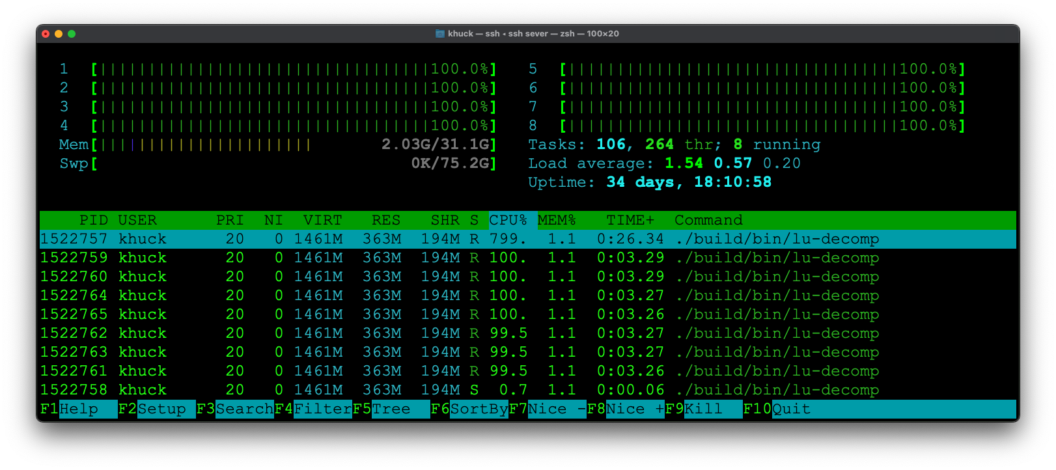
Utilization
Resource Monitor, Activity Monitor, menumeters, top, htop, NVML, ROCm-SMI, etc.
  We LOVE these!
Why can’t we have that for HPC?
  System admins do!
  LDMS, Ganglia, Puppet Console, TACC Stats, JobStats, etc.
…for the user?
Figures: time series monitor data from APEX performance measurement tool
https://github.com/UO-OACISS/apex/

Slide 9
Caveat: Monitoring != Explicit Measurement
Monitoring Data (periodic)
Progress Data (events)
Example: APEX data from Lulesh Kokkos with CUDA back end, visualized with Python – clear need for GPU HWM

Slide 10
What is the hardware / operating system doing?
Kernel monitoring is popular and useful (strace, ptrace, dtrace, dtruss, ftrace, KUtrace, kprobe, system-tap, KTAU, STaKTAU, eBPF, bpftrace, BCC, …)
Nataraj, Morris, Malony, Sottile, and Beckman. "The Ghost in the Machine: Observing the Effects of Kernel Operation on Parallel Application Performance." In SC2007, pp. 1-12. 2007.
Subsystem monitoring (Darshan)
Did I ask for the right thing?
Will I run out of a limited resource?
Are there alternatives?
Can I get this information without being root? Without spawning another process to monitor my process? Without kernel patches/support? Low/no overhead?

Slide 11
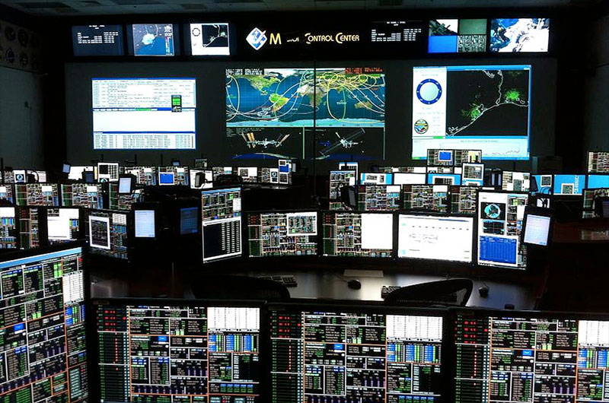
What (we think) users DON’T want:
Sources: https://www.space.com/22652-nasa-redesigns-mission-control.html

Slide 12
ZeroSum: User Space Monitoring of Resource Utilization and Contention
Inspired by the hello_jsub program from Tom Papatheodore - https://code.ornl.gov/t4p/Hello_jsrun
Name “ZeroSum” comes from:
  the fixed number of resources available in an allocation
  the need to periodically use some resources in order to monitor
Available on GitHub: https://github.com/khuck/zerosum
Monitors application threads (LWP), CPU hardware (HWT), Memory, and GPU hardware for all processes, all nodes in the allocation
Prototype solution to two problems:
  Configuration optimization – help understand new system/software
  Ongoing usage for monitoring/adaptation

Slide 13
Proposed Functionality for ZeroSum
Detect the initial/changing configuration of the application
Evaluate the configuration to automatically detect misconfigurations
Provide runtime feedback to the user that the program is progressing
Provide a report of how effectively the hardware was utilized
Provide a report of how much contention was identified in the execution
Provide a way to export the observed data to other tools that can perform computational steering, if desired
Implemented
Future work
(Our foci today)

Slide 14
How to use ZeroSum
Wrapper script(s) – zerosum and zerosum-mpi
  Periodicity – default 1 second
  HWT/Core for async thread – defaults to last core/HWT in affinity list for process
  Detailed output – true/false, default false
  Verbose output – true/false, default false
  Heartbeat – true/false, default false
  Register signal handler – true/false, default false
Preloads the library, wraps __libc_start_main or creates global static constructor/destructor functions
MPI implementation includes wrappers for MPI_Recv/Irecv, MPI_Sendrecv, MPI_Send/Bsend/Isend/Rsend/Ssend to capture P2P frequency, volume

Slide 15
Configuration Detection
Query /proc/[self|pid]/status to get the allowable cores
Query /proc/meminfo to get total memory available
Query MPI rank, size, hostname
If available, use hwloc to query cpu topology (lstopo)
Asynchronous background thread is started, it periodically queries:
  /proc/[self|pid]/status to get process thread count, memory usage
  /proc/[self|pid]/task directory to get all thread IDs
  For each thread, query the affinity list for that thread (it may change!), utilization, state, core/HWT it’s running on, context switches
  /proc/stat to query core utilization of all cores
OMP-Tools (v5.0+) callback used to identify OpenMP threads at creation
NVML/ROCm-SMI/SYCL libraries used to query GPU(s)*

Slide 16
Utilization Report
Rank 0 writes a summary report to the screen
All ranks write a report to a log file – including full time series data as CSV
All observed threads (LWP) are reported – user/system/idle, context switches, affinity list
All assigned cores (HWT) are reported – user/system/idle
All assigned GPUs are reported – stats captured with NVML or ROCm-SMI, SYCL has limited support (memory only)

Slide 17
Example Output – miniQMC (OpenMP target offload) on Frontier (OLCF)
Process Summary
LWP (thread) Summary
Note: times are % of total

Slide 18
Example Output – miniQMC (OpenMP target offload) on Frontier (OLCF)
HWT (core/thread) Summary
Note: times are % of total
GPU Summary

Slide 19
Contention Detection Support
(Non) voluntary context switches
Minor/major page faults, pages swapped
System time
Comparing affinity lists – across threads and across processes
Memory consumption
GPU memory consumption
Currently a manual process
Not automated yet – but should be straightforward…

Slide 20
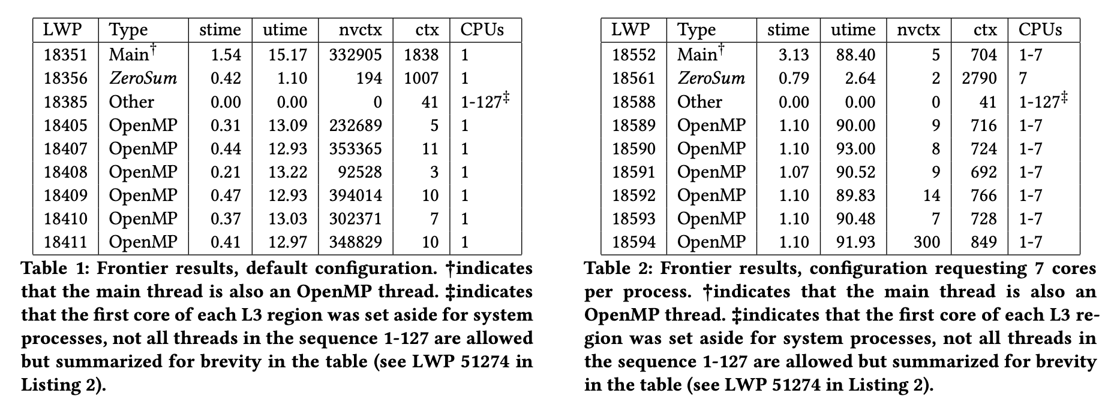
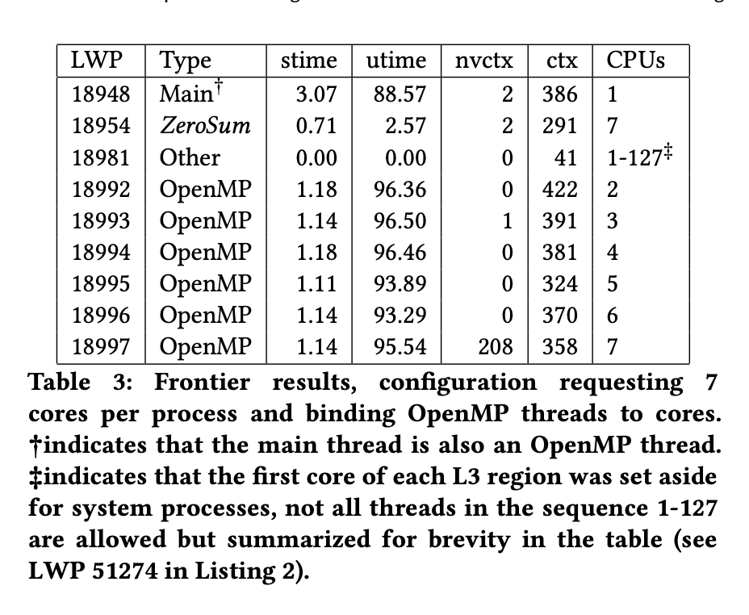
Evaluation / Example usage
MPI+OpenMP version of miniQMC on Frontier, 8 processes, 7 threads (64 cores, 1 thread per core, 8 cores reserved)
export OMP_NUM_THREADS=7
srun -n8 zerosum-mpi miniqmc
export OMP_NUM_THREADS=7
export OMP_PROC_BIND=spread
export OMP_PLACES=cores
srun -n8 –c7 zerosum-mpi miniqmc
export OMP_NUM_THREADS=7
srun -n8 –c7 zerosum-mpi miniqmc
Note: stime/utime reported as % of total time

Slide 21
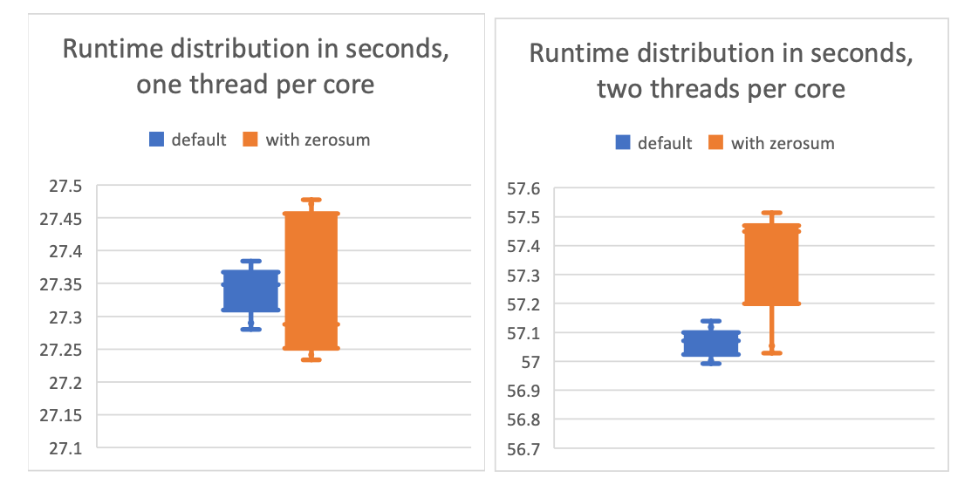
Overhead – less than 0.5% in resource constrained example
miniQMC time distributions executed 10 times using one OpenMP thread per core (left). In this comparison, the distribution of times with ZeroSum is noisier, but there is no significant observation of measurable overhead. The right figure shows the time distributions using two OpenMP threads per core. In this comparison, the distribution of times with ZeroSum is both noisier and longer tailed, and does show an observation of overhead, averaging about 0.2752 seconds, or 0.5%.

Slide 22
Conclusions, Future Work
ZeroSum meets a need – it addresses the configuration optimization problem
  Future development driven by user requests
  https://github.com/khuck/zerosum (will move to UO-OACISS group eventually)
Need automated misconfiguration/contention detection, deadlock detection(?)
Output data could be better – use ADIOS2 BP5? HDF5?
  Depends on analysis needs/wants
  Current log file “format” means analysis process is manual/ad hoc for now
Streaming data to Mochi (SOMA) or other service (LDMS)?
  Enables robust monitoring approach
Integration with performance tools (TAU, APEX, etc)
  Analysis of application performance data in context of system monitoring data
Input for automated feedback/control (APEX, Argobots, SOMA, application, etc.)

Slide 23



Acknowledgements
Parts of this research was supported by the Exascale Computing Project (17-SC-20-SC), a joint project of the U.S. Department of Energy’s Office of Science and National Nuclear Security Administration, responsible for delivering a capable exascale ecosystem, including software, applications, and hardware technology, to support the nation’s exascale computing imperative.
This research used resources of the Oak Ridge Leadership Computing Facility at the Oak Ridge National Laboratory, which is supported by the Office of Science of the U.S. Department of Energy under Contract No. DE-AC05-00OR22725.

Slide 24
Thanks! Questions?

